Slide 1
Corning Scope 3 Emission Program

Slide 2
Information security
This presentation contains Corning information and is intended solely for those with a need to know. It may not be distributed, in whole or part, in any form by any means, or by any person or organization without authorization from Corning Incorporated.
Notes:
This deck is for internal use only.

Slide 3



GHG 101: Scope 3
Speakers
Susan McNichols
Project Consultant WSP,
Sustainability Energy and Climate Change
Adeola Adeusi
Project Manager,
Global Supply Management Corning Inc.

Slide 4
Planned Training Webinars
Training Topic | Webinar Date
Scopes 1&2 Accounting Training | Complete
Scope 3 Accounting Training | May 11th
Setting a Science Based Target Training | May 18th
Renewable Energy Target and Procurement Training | May 25th
Product Carbon Footprint Training | June 1st
Suppliers that are required to attend specific trainings based on maturity level will be notified by email. All trainings are optional for all suppliers.

Slide 5
Agenda
Scope 3 GHG Accounting
Webinar Objectives
Corning Overview and Supplier Expectations
Introduction to Scope 3 Greenhouse Gases and Inventories
Next Steps and Resources
CDP Reporting and Data Collection
Details by Upstream Scope 3 Category

Slide 6
Webinar Objectives

Slide 7

Webinar Objectives
  Understand Corning’s updated supplier expectations
  Understand the key data requirements and data sources for upstream scope 3 emissions calculation
  Understand how to calculate your organization’s scope 3 emissions for categories 1, 2 and 4

Slide 8
Corning Scope 3 Emission Program
Adeola Adeusi

Slide 9
Our Approach
To Sustainability
At Corning, we take a long-term approach to sustainability,
as we address key challenges of the moment and evolve to meet the needs of the future.
We think about our contributions in two categories. One is
our footprint – how our actions directly affect others in
areas such as gender pay equity and carbon emissions from our operations. The other is our handprint – what we enable others to do through our products and services, such as helping to deliver over 8 billion COVID-19 vaccine doses
to date through our glass vials.
We prioritize areas where we have distinctive capabilities
to create value for our shareholders and meaningful progress for society. We also emphasize areas where our stakeholders are looking for us to set an example – areas such as supporting human rights in our supply chain, advancing gender equity, and acting with integrity in all we do.
Investing in these areas also makes us more resilient and supports our ability to do what we do best – innovate.
“Quite simply, we’ve succeeded over the long term by always working to become better versions of ourselves. We never lose sight of our purpose, our Values, and the importance of engaging with – and delivering for – key stakeholders. And that’s “our why” – we always seek to advance and apply our leadership capabilities to make a positive difference in the world.”
Wendell P. Weeks
Chairman and Chief Executive Officer

Slide 10








2023 Corning Sustainability Goals
Reduce our absolute Scope 1 and 2 greenhouse gas (GHG) emissions 30% by 2028 from a 2021 base year
Reduce our absolute Scope 3 GHG emissions, covering purchased goods and services, capital goods, fuel- and energy-related activities, and upstream transportation and distribution 17.5% by 2028 from a 2021 base year
Increase our use of renewable energy by 400% by 2030 from a 2018 baseline
By the end of 2023, assess Corning’s exposure to water stress
By the end of 2024, Corning will be generating monthly, accurate, and comprehensive water use data for our top 10 water-use facilities
By the end of 2028, Corning will increase its waste diversion rate to greater than 80% globally
New!
By the end of 2023, Corning will be generating monthly, accurate, and comprehensive landfill waste and diverted waste data for our top 10 waste-generating sites
Certify 100% of our high-risk suppliers as socially responsible by 2025
Reduce our total recordable case incident rate (TRIR) within the portion of our operations that disproportionately contribute to our overall recordable injury and illness rate by at least 10%
Encourage increased volunteerism efforts year over year by supporting, rewarding, and recognizing employees’ efforts in the community
Achieve understanding of the Corning Code of Conduct, including how to report allegations of ethical or legal misconduct, among 100% of employees
New!
New!
New!
New!
Notes:
We have set goals within these focus areas and we are working diligently to achieve them. These goals were developed to support the united nations sustainable development goals aligning Corning’s efforts with global action on sustainability.
Didi will talk about our greenhouse gas reduction goals. We also introduced new water, waste and safety goals.
One that is very relevant to this group is our waste goals!
The following goals were graduated:
Maintain a diverse Board of Directors Corporate Governance and Risk Management
Conduct an annual review of the Sustainability Program by the Board of Directors Corporate Responsibility and Sustainability Committee Corporate Governance and Risk Management
Address environmental, social and governance issues in our Enterprise Risk Management Process Corporate Governance and Risk Management
Issue a sustainability report in 2021 and every year thereafter Transparency and Reporting
Continue advocacy for environmental and social issues Environmental and Social Advocacy SDG 12

Slide 11

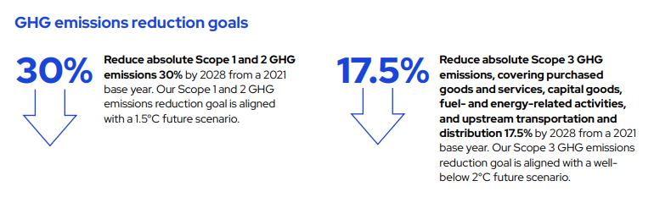
Greenhouse Gas (GHG) Emissions Reduction Goals
In 2022, Corning submitted targets for validation to the Science Based Targets initiative (SBTi), underscoring our commitment to set near-term company-wide emission reductions in line with Climate science, and aligning with the goals of the Paris Agreement.

Slide 12
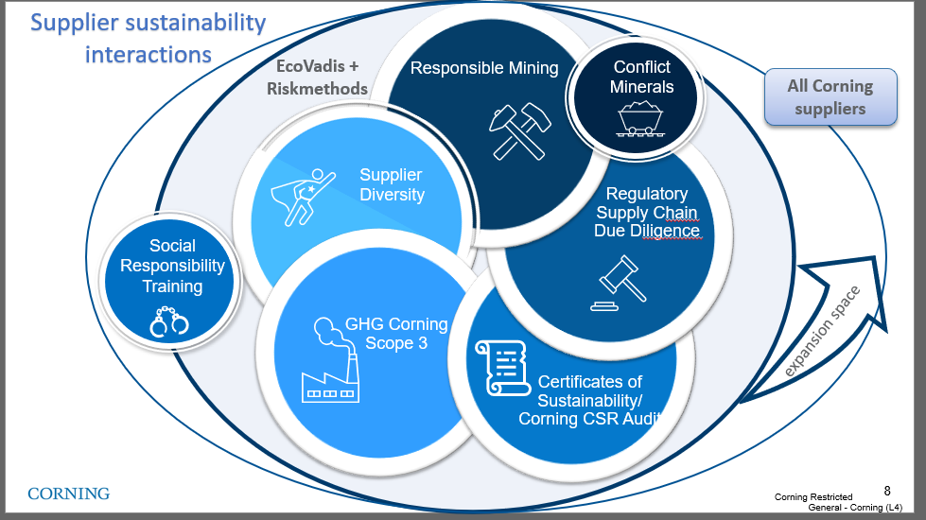
Climate Change is part of GSM's sustainability strategy
Our management of
Sustainable Supply Chain
Working with our suppliers globally, with a focus on Corporate Social Responsibility (CSR) and Climate Change Issues reduces our supply disruption risk and exposure to regulatory and reputational risk.
Our aim is to establish standardized, verified information-based management process contributing to Corning's long-term commitment on sustainable supply.
Supply Chain Sustainability Strategy
Scope 3 program
Last update Jan 2023
Notes:
CO₂ – Carbon dioxide
CH₄ – Methane
N₂O – Nitrous oxide (laughing gas)
HFC_{s} – Hydrofluorocarbons (refrigeration units, fire extinguishers, aerosols….)
PFC_{s} – Perfluorochemicals (heat, oil, water, etc., resistant coatings – think cookware, carpet stain prevention for regular people lives) mess up the endocrine activity, reduce immune function etc..
SF₆ – Sulfur hexafluoride – circuit breakers, arc suppressant , electrical insulator, semiconductor manufacturing, and the production of magnesium. One of the more potent GHG’s – it only takes a small amount to do significant damage. Used in the manufacturing as well as maintenance of grid equipment. One mitigation tactic is to regularly check equipment quality for leaks , training on employees how to maintain and service WHILE new options are being discovered.

Slide 13
2023 supplier engagement goals defined and set for deployment
Program
Deployment
Active Engagement
Emission Reduction Plan
Communicate supplier
engagement program to the suppliers that contribute 80% of Corning/Hemlock scope 3 emissions.
(PG&S, Capital Goods, Transportation)
Develop and implement emission reduction plans with supplier classified as engaged leaders in the scope emissions program
Actively engage and train the suppliers that contribute 60% of emissions in PG&S,CAP category and 80% in the Transportation
Corning approved channel
CDP supply chain program

Slide 14
2023 Supplier Activities for Scope 3 Emission
1
1
Register/ Sign up for CDP
If you company did not disclosure through CDP in 2022, please register your account.
2
Attend Trainings
2
GHG emission topics hosted by Corning/WSP
3
Calculate Emission data
3
Disclose scope 1, 2 and 3 greenhouse gas (GHG) emissions data. Provide independent or third-party assurance of disclosed emissions
4
  Submit data and Allocate emission
4
Submit data through CDP. Deadline July 26th
5
  Reduce Emissions
Adopt a science-based (SBTi-approved) emissions reduction target
Set a renewable energy target and water management goal
5

Slide 15

Partnership is Critical
Collaboration with suppliers will be key to enabling Corning to achieve our Scope 3 emissions reduction goal.
Working with Suppliers to Reduce Upstream Emissions
Together with our partners, Corning will continue to reduce global GHG emissions aligned with our commitment to climate action.
Corning will be rolling out our formal supplier engagement program in 2023 to reduce upstream emissions from suppliers systematically
Corning’s new product innovations are increasingly focused on reducing embodied carbon in our products and our customers’ products and operations.
Integrating Sustainability into Our Innovation Process
Corning has begun to use life cycle assessments performed by third parties to provide industry-recognized calculations of embodied carbon and we will request additional LCA information from suppliers through our supplier engagement program.
We are also developing GHG-impact estimates to be used in the early-stage design of products.

Slide 16

Corning Scope 3 Supplier Expectations
Suppliers engaged starting in 2023 are expected to adhere to these requirements by 2026:
Disclose scope 1, 2 and 3 greenhouse gas (GHG) emissions data through CDP Supply Chain
Provide independent or third-party assurance of disclosed emissions
Adopt a science-based (SBTi-approved) emissions reduction target
Set a renewable energy target
Respond to CDP Water Questionnaire
Set a water management goal

Slide 17
Introduction to Scope 3 Greenhouse Gases and Inventories

Slide 18
Poll the Audience
GHG Accounting 101: Scope 3
Has your company calculated Scope 3 GHG emissions before? If yes, for which scope 3 categories?
  Please type your answer into the chat box

Slide 19
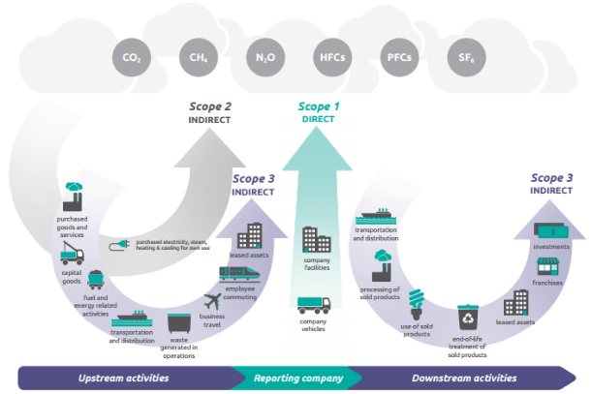
Operational Boundary: Scopes 1 , 2 & 3
GHG emissions are organized into categories, or “scopes”:
  Scope 1: direct emissions from fuel combustion and refrigerant leakage from company facilities and vehicles
  Scope 2: indirect emissions from the purchase of electricity, steam, heat, and cooling
  Scope 3: indirect emissions from a company’s value chain (e.g., purchased goods and services, use of sold products)
Source: Greenhouse Gas Protocol Corporate Value Chain (Scope 3) Accounting and Reporting Standard - page 7

Slide 20
GHG Inventory Steps
1. Scope
and Plan
2. Collect
Data
3. Review and Estimate Data
4. Finalize
and Report
5. Target Setting
  Review GHG accounting standards and methods for company reporting
  Determine boundaries - organizational and operational
  Identify data requirements and preferred methods for data collection
  Develop data collection procedures, tools, and guidance materials
  Compile facility data
  Review facility-level data and resolve potential issues
  Estimate missing data to fill gaps
  Calculate GHG emissions
  Finalize data
  Formalize data collection procedures
  Complete third-party verification (optional)
  Report requested data
  Set a GHG reduction target
Notes:
Review and Estimate Data
Review facility-level data and resolve potential issues
Quality assurance is crucial to an accurate, complete, and consistent inventory
Identify gaps and outliers
Chart data and visually inspect for issues
Compare data over time (if you have multiple years)
Look at percent change and total absolute change from prior year and flag large changes for review/questions
Focus on the largest issues – those sites that make up the bulk of your impact, and those changes that account for the majority of the overall change
Check energy intensities
Energy use per square foot, per production – whatever metric is informative for your business
Look for unusually high and low intensities
Spot check utility invoices – obtain copies of the original invoice and ensure data have been entered correctly
This step applies even if you have a central utility database
Request clarification from data providers to resolve any issues that you found
Make your questions as specific as possible
Don’t be afraid to ask follow up questions
Document issues and resolutions
Crucial to a transparent, consistent inventory
Estimate missing data
We will talk about this in more detail in a moment
Finalize and Report
Finalize data
Compile enterprise-wide data
Summarize data by business unit, by facility, by region, or other ways that are relevant to your business
Calculate relevant intensities, such as GHG per unit of revenue
Formalize data collection procedures
Compile data collection, review, estimation and compilation procedures into a single document
You should use this document in future years to guide your process to ensure consistency, comparability and transparency
Complete 3rd party verification, if pursuing
Provide all calculation files, source data and procedural documents to the verifier
Plan to provide a sample of utility invoices for them to review
Answer questions – ideally you will be ready to answer any questions they may have, because you have clearly documented your quality assurance process
Report requested data
Input your quantitative results into your CDP response
Report through other means, such as sustainability reports and customer data requests

Slide 21
Sources of GHG Emissions by Scope
Scope 1 | Scope 2 | Scope 3 – Upstream | Scope 3 – Downstream
Fuels used in operations Natural gas Fuel oil Diesel Gasoline Propane Refrigerants and process gases Mobile fuels used in vehicles Gasoline Diesel Biodiesel | Purchased utilities Electricity Steam / heat Chilled water | Purchased goods and services Capital goods Fuel- and energy-related activities Upstream transportation and distribution Waste generated in operations Business travel Employee commuting Upstream leased assets | Downstream transportation and distribution Processing of sold products Use of sold products End-of-life treatment of sold products Downstream leased assets Franchises Investments

Slide 22
Business Value of Quantifying Value Chain Emissions
Business value of quantifying value chain emissions
Significant GHG Category
Scope 3 is likely the largest source of your company’s emissions
May represent the most significant opportunities to influence GHG reductions
Reporting, Transparency and Goal Setting
Investors, rating agencies, business partners and nongovernmental organizations increasingly request and expect Scope 3 inventories
Quantification required for setting SBTi approved targets
Efficiency Improvement Opportunity
Identify or help quantify value chain inefficiencies (i.e. distribution location or modes, manufacturer impacts)
Can support identification and reduction of supply chain climate risks

Slide 23
GHG Emissions Calculation Resources and Tools
Calculating GHG emissions is a multi-step process; many tools can help to develop your GHG inventory.
GHG Protocol standards and guidance
  Guidance to companies preparing a corporate GHG emissions inventory
  Corporate Accounting and Reporting Standard and Scope 2 Guidance
  Corporate Value Chain (Scope 3) Standard and Technical Calculation Guidance
EPA's Center for Corporate Climate Leadership
  Resources for companies seeking to measure and manage GHG emissions
  Simplified GHG Emissions Calculator: tool to help small business and low emitter companies calculate annual GHG emissions
Quantis Scope 3 Evaluator is a tool that can be used to calculate screening level scope 3 emissions for the first time.
Notes:
Note that if they use a tool like this, we would like them to state that in their CDP response

Slide 24
CDP Reporting and Data Collection
Susan

Slide 25
Poll the Audience
GHG Accounting 101: Scope 3
Has your company reported any Scope 3 emissions through CDP before?
  Please type your answer into the chat box

Slide 26






Target Questions:
Greenhouse Gas Emissions Data & Energy Usage
2022 MODULES
C0 Introduction
C1 Governance
C2 Risks and opportunities
C3 Business strategy
C4 Targets and performance
C5 Emissions methodology
C6 Emissions data
C7 Emissions breakdown
C8 Energy
C9 Additional metrics
C10 Verification
C11 Carbon pricing
C12 Engagement
C15 Biodiversity
C16 Signoff
SC Supply Chain
Scope 1 – Greenhouse gases that your company emits (C6.1)
Company Facilities
Company Vehicles
Scope 2 – Greenhouse gases that others emit due to your energy use (C6.2 & C6.3)
Purchased electricity, steam,
heating & cooling, for own use
Scope 3 – Everything else (C6.5)
Supplier emissions
Product use
Employee commuting
*We ask if you already have calculated emissions for 2021 you report them in addition to your 2022 emissions in CDP questions C6.1, 6.3 and 6.5​
Notes:
Summary of GHG questions.

Slide 27
Scope 3 Emissions Categories
Upstream
Purchased Goods & Services
Downstream
Scope 3 Categories
Capital Goods
Fuel & Energy Related Activities
Upstream transportation
Waste Generated
Business Travel
Employee Commuting
Upstream Leased Assets
.
Downstream Transportation & Distribution
Processing of Sold Products
Use of Sold Products
End of life treatment of sold products
Downstream Leased assets
Franchises
Investments
Corning’s Priority
If relevant, calculation required for science-based target approval by SBTi (can be calculated using screening level methods)

Slide 28
Scope 3 Emissions
There are various ways to calculate Scope 3 emissions depending on the category.
When starting out, it is recommended to use the spend based method where you can apply emission factors based on a dollar value
As you begin to build out your sustainability capabilities, you can begin to incorporate more specific methods. For example, using product data to calculate the carbon intensity of units sold or using distance travelled for logistics suppliers.
Spend Based
Mass Based
Hybrid
Supplier Specific

Slide 29
Data expectations and boundaries
Available: seeking data from existing systems and reports
Annual: aligned with current reporting year
Global and Comprehensive: Domestic and international, direct and indirect spend, goods and services
Uniform: global data converted to same unit of measure (i.e., US Dollars)
Detailed: enough detail on spend type and suppliers to sort into categories such as type of goods, materials, services or industries (i.e., rubber, office supplies, waste hauling, shipping, legal fees)
Actual: spend or activity data within the calendar year excluding depreciation, discounting, amortization, internal transfers or activities (which might result in double-counting), taxes, payroll, etc.
Repeatable: Create streamlined data management process for consistent annual reporting

Slide 30
Details by Upstream
Scope 3 Category

Slide 31
Category 1 and 2 – Purchased Goods and Services and Capital Goods (Priority Category to Calculate)

Slide 32

Definition and Data Collection
Category 1 and 2: Purchased Goods and Service and Capital Goods
The extraction, production, and transportation of goods and services purchased or acquired in the reporting period
Includes both physical goods and services (e.g. consulting or legal services)
Capital goods are final products with extended life & used by company to manufacture a product; provide a service; sell, store, or deliver merchandise.
Examples of capital goods are computers, servers, office equipment, HVAC, other equipment and machinery, furniture, vehicles, buildings
Exclude spend on taxes, payroll, fines, compensation, insurance premiums
Data Requirements
Aggregated total spend by standard product category or industry, and by supplier / vendor
Separated into Capital and non-Capital goods, if possible
Potential Data Sources
Procurement / supply chain
Finance / Treasury
Notes:
1: Spend data associated with any goods or services (i.e. consulting services, equipment costs, etc.), Companies may find it useful to differentiate between purchases of production-related products (e.g., materials, components, and parts) and non-production-related products (e.g., office furniture, office supplies, and IT support). This distinction may be aligned with procurement practices and therefore may be a useful way to more efficiently organize and collect data ​
Spend-based method – estimates emissions for goods and services by collecting data on the economic value of goods and services purchased and multiplying it by relevant secondary (e.g., industry average) emission factors (e.g., average emissions per monetary value of goods). All emissions are based on secondary EEIO data, US EPA Environmentally-Extended Inputs-Outputs​
Data Needed: Amount spent on purchased goods or services, by product type, using market values (e.g., dollars)​ -- procurement database?
a) complete & comprehensive b) (nice to have) vendor name c) industry or sector classification from procurement dept.
If decentralized procurement… regional division data that we can consolidate
​
2: Capital goods are final products that have an extended life and are used by the company to manufacture a product; provide a service; or sell, store, and deliver merchandise. In financial accounting, capital goods are treated as fixed assets or as plant, property, and equipment (PP&E). Examples of capital goods include equipment, machinery, buildings, facilities, and vehicles. In financial accounting, capital goods (sometimes called “capital assets”) are typically depreciated or amortized over the life of the asset. For purposes of accounting for scope 3 emissions, companies should not depreciate, discount, or amortize the emissions from the production of capital goods over time. Instead companies should account for the total cradle-to-gate emissions of purchased capital goods in the year of acquisition, the same way the company accounts for emissions from other purchased products in category 1. If major capital purchases occur only once every few years, scope 3 emissions from capital goods may fluctuate significantly from year to year. Companies should provide appropriate context in the public report (e.g., by highlighting exceptional or non-recurring capital investments).​
Average spend-based method, which involves estimating emissions for goods by collecting data on the economic value of goods purchased and multiplying by relevant secondary (e.g., industry average) emission factors (e.g., average emissions per monetary value of goods)​

Slide 33
Data Analysis
Category 1 and 2: Purchased Goods and Service and Capital Goods
Internal Spend and Associated Spend Categorization Data Provided
Map Internal Spend Categories to Industry Emissions Factor Categories
Calculate Emissions Associated with Spend
Companies should create a standard and transparent mapping process to link internal spend categorization to emissions factor categorizations
Internal Categorization
IT – Engineering Software
Associated US EPA EEIO Factor Category
Publishing industries, except internet (includes software)
Emissions Factor
0.07 (kg CO₂e/USD) for Publishing industries, except internet (includes software)
Emissions factors relate an activity with the quantity of a pollutant released to the atmosphere from that activity
Common emissions factor sources for purchased goods and services and capital goods include
  US EPA Environmentally Extended Input Output Factors (EEIO)
  UK Department for Environment, Food and Rural Affairs Factors (DEFRA)

Slide 34
Sample Calculation Scope 3 Category 1 and 2
An organization purchased goods and services and capital goods in the reporting year as follows:
$1,000,000 spent on Data processing, internet publishing, and other information services
$200,000 spent on Paper products
$3,000,000 spent on Publishing industries, except internet (includes software)
Emissions Factor Source: Supply Chain Greenhouse Gas Emission Factors for US Industries and Commodities
Emissions Calculation by Category
Conversion to mtCO2e
Total Emissions
Data processing, internet publishing, and other information services
$1,000,000 x 0.162 (kg CO₂e /USD) = 162,000 kg CO₂e
162,000 kg CO₂e / 1,000 = 162 mt CO₂e
162 + 111.8 + 210 = 483.8 mt CO₂e
$200,000 x 0.559 (kg CO₂e /USD) = 111,800 kg CO₂e
111,800 kg CO₂e / 1,000 = 111.8 mt CO₂e
Paper Products
Publishing industries, except internet (includes software)
$3,000,000 x 0.07 (kg CO₂e /USD) = 210,000 kg CO₂e
210,000 kg CO₂e / 1,000 = 210 mt CO₂e
The total Scope 3 Category 1 and 2 emissions related to the company’s purchased goods and services and capital goods is 483.8 mt CO₂e

Slide 35
Category 3 – Fuel and Energy Related Activities

Slide 36

Definition and Data Collection
Category 3: Fuel and Energy Related Activities
The extraction, production, and transportation of energy (fuels and electricity) consumed in the reporting period that are not included in scope 1 or 2
Data Requirements
The activity data used to quantify these activities' emissions are the quantity consumed of each energy type, such as electricity or natural gas.
No additional data required beyond what is already obtained for the Scope 1 and 2 GHG Inventory
Potential Data Sources
Scope 1 & 2 GHG inventory
Utility bills, fuel purchase records and other documentation
Notes:
3: Emissions associated with extraction, generation and transportation of fuel and energy-related activities that are not accounted for in scope 1 and 2​
Activity Data Needed: Quantities and types of fuel consumed (which is already being collected for scope 1 and 2)

Slide 37
Category 4 – Upstream Transportation (Priority Category to Calculate)

Slide 38

Definition and Data Collection
Category 4: Upstream Transportation and Distribution
Transportation and distribution of products purchased by the organization between Tier 1 suppliers and operations (in vehicles and facilities not owned or controlled by the organization)
Other third-party transportation and distribution services purchased by the organization, including inbound logistics, outbound logistics (e.g. of sold products), and transportation and distribution between a company’s own facilities (in vehicles and facilities not owned or controlled by the organization)
Includes emissions from both transportation and storage, though transportation is likely the more significant source.
Data Requirements
Ton-miles by transport mode
Tons shipped or miles shipped
**OR**
Aggregated spend by supplier on third-party transport by transport mode
Aggregated spend by supplier on third-party distribution by distribution type
Potential Data Sources
Transportation / logistics team
Shipping suppliers / vendors (e.g. FedEx, UPS)
Notes:
4: Emissions may arise from the following transportation and distribution activities throughout the value chain: • Air transport • Rail transport • Road transport • Marine transport • Storage of purchased products in warehouses, distribution centers, and retail facilities​
FedEx/USPS/UPS?​
Fuel-based method, which involves determining the amount of fuel consumed (i.e., scope 1 and scope 2 emissions of transport providers) and applying the appropriate emission factor for that fuel ​
Distance-based method, which involves determining the mass, distance, and mode of each shipment, then applying the appropriate mass-distance emission factor for the vehicle used ​
Spend-based method, which involves determining the amount of money spent on each mode of business travel transport and applying secondary (EEIO) emission factors​
Data request: centralized logistics teams (inbound/outbound shipment data) – any situation where HBF is paying to ship an inbound good for ops or paying ship to customers (i.e. marketing materials). However, if these costs are passed down to the customer this may fall into downstream T&D.
​
​

Slide 39
Calculation Methods
Category 4: Upstream Transportation and Distribution
Fuel-based method, which involves determining the amount of fuel consumed (i.e., scope 1 and scope 2 emissions of transport providers) and applying the appropriate emission factor for that fuel ​
Distance-based method, which involves determining the mass, distance, and mode of each shipment, then applying the appropriate mass-distance emission factor for the vehicle used ​
Spend-based method, which involves determining the amount of money spent on each mode of business travel transport and applying secondary (EEIO) emission factors​

Slide 40
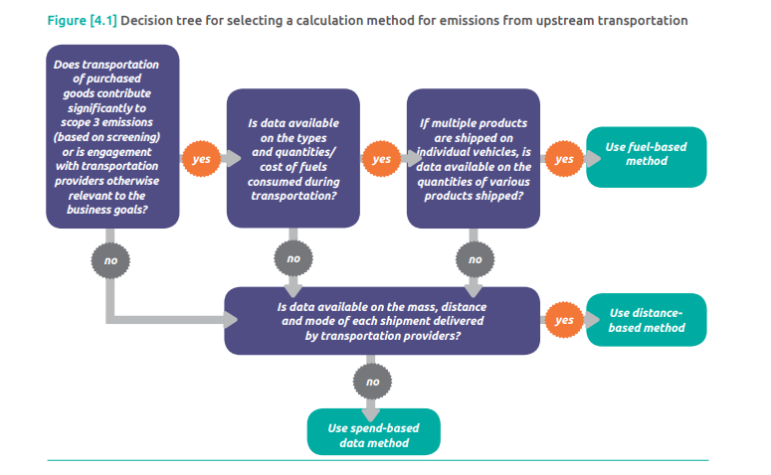
Selecting which Calculation Method to Use
Category 4: Upstream Transportation and Distribution
Source: https://ghgprotocol.org/sites/default/files/standards_supporting/Chapter4.pdf

Slide 41
Sample Calculation Scope 3 Category 4 (Distance-Based Method)
Supplier | Mass Transported (tonne) | Distance Transported (km) | Transport mode or vehicle type | Emissions Factor (kgCO2e/tonne-km)
1 | 20,000 | 2,000 | Truck (rigid, > 3.5-7.5t) | 0.2
2 | 10,000 | 3,000 | Air (long haul) | 1.0
3 | 600,000 | 4,000 | Container (2,000-2,999TEU) | 0.05
Mode | Emissions Calculation
Truck | 20,000 tonnne x 2,000km x 0.2 kgCO₂e/tonne-km = 8,000,000 kg CO₂e
Air | 10,000 tonne x 3,000 km x 1 kgCO₂e/tonne-km = 30,000,000 kg CO₂e
Sea | 600,000 tonne x 4,000 km x 0.05 kgCO₂e/tonne-km = 120,000,000 kg CO₂e
Total Emissions | 8,000,000 + 30,000,000 + 120,000,000 = 158,000,000 kg CO₂e/1,000 = 158,000 mtCO₂e
The total Scope 3 Category 4 emissions related to the company’s upstream transportation is 158,000 mt CO₂e

Slide 42
Category 5 – Waste Generated in Operations

Slide 43

Definition and Data Collection
Category 5: Waste Generated in Operations
Disposal and treatment of solid waste generated in the organization’s operations and wastewater management
Data Requirements
Total waste quantity (e.g., mass), composition (e.g., plastic), and disposal method (e.g., landfilling, wastewater treatment )
Potential Data Sources
Facilities management
Procurement: Waste Spend
Waste management vendors
Individual facilities, as needed
Notes:
5: Activity data needed Companies should collect: • Total mass of waste generated in operations • Proportion of this waste being treated by different methods (e.g., percent landfilled, incinerated, recycled). Because many waste operators charge for waste by disposal method, this data may be collected from utility bills. The information may also be stored on internal IT systems.​
- Could also be calculated on waste spend / year
​

Slide 44
Category 6 – Business Travel

Slide 45

Definition and Data Collection
Category 6: Business Travel
Emissions from the transportation of employees for business-related activities during the reporting period (in vehicles not owned or operated by the organization), such as commercial aircraft, trains, buses, and passenger cars or taxis
May include emissions from business travelers staying in hotels
Depending on data availability, it may be acceptable to include only most significant sources or activities - e.g., air travel only
Data Requirements
Air / rail data: Spend, Passenger miles traveled (aggregated by origin/destination city pairs), travel class
Rental car data: Spend, fuel consumption by type, miles traveled, Vehicle class
Hotel nights by hotel type or vendor
Potential Data Sources
Travel agency vendors (e.g. AMEX, Hertz, Egencia etc.)
Employee expense reports
Notes:
6. Distance-based method, which involves determining the distance and mode of business trips, then applying the appropriate emission factor for the mode used. Data: Total distance travelled by each mode of transport (air, train, bus, car, etc.) for employees in the reporting year​
​

Slide 46
Category 7 – Employee Commuting

Slide 47

Definition and Data Collection
Category 7: Employee Commuting
Emissions from the transportation of employees between their homes and worksites in the reporting period
Includes automobile, bus, rail, air, or other travel modes
Includes contracted shuttles for employees
Includes optional work-from-home emissions
Data Requirements
Distance traveled per commuting trip, # of commuting trips per year, by transport mode
Total Global Headcount
Potential Data Sources
HR: Employee headcount
Commuting survey (full company or partial); include in surveys already conducted
Notes:
7: 2 primary methodologies:​
Distance-based method, which involves collecting data from employees on commuting patterns (e.g., distance travelled and mode used for commuting) and applying appropriate emission factors for the modes used ​
Average-data method, which involves estimating emissions from employee commuting based on average (e.g., Census) data on commuting patterns.​
​

Slide 48
Category 8 – Upstream Leased Assets

Slide 49

Definition and Data Collection
Category 8: Upstream Leased Assets
Emissions from the operation of assets that are leased by the organization in the reporting period and not already included in the organization’s scope 1 or scope 2 inventory boundary
Data Requirements
Data for assets leased by your company
Potential Data Sources
Facilities / property management
Corporate real estate
Data center team
Notes:
​8: confirm if there are any leased buildings. If yes, confirm they are included in scope 1 and 2

Slide 50
Next Steps and Resources

Slide 51
Next Steps
GHG 101: Scope 3
Look forward to the upcoming Setting a Science Based Target Training on May 18th
Socialize new expectations of Corning suppliers
  Disclose scope 1, 2 and 3 greenhouse gas (GHG) emissions data through CDP Supply Chain.
    We ask if you already have calculated emissions for 2021 you report them in addition to your 2022 emissions in CDP questions C6.1, 6.3 and 6.5
  Provide independent or third-party assurance of disclosed emissions
If you are completing your scope 3 GHG Inventory for the first time, please reference the resources provided, including this Quantis Scope 3 Evaluator which is a tool to help you quantify scope 3 emissions
Prioritize calculations of categories 1, 2, and 4 if you don’t have the capacity to calculate all 8 upstream categories this year

Slide 52
GHG Emissions Calculation Resources and Tools
Calculating GHG emissions is a multi-step process; many tools can help to develop your GHG inventory.
GHG Protocol standards and guidance
  Guidance to companies preparing a corporate GHG emissions inventory
  Corporate Accounting and Reporting Standard and Scope 2 Guidance
  Corporate Value Chain (Scope 3) Standard and Technical Calculation Guidance
EPA's Center for Corporate Climate Leadership
  Resources for companies seeking to measure and manage GHG emissions
  Simplified GHG Emissions Calculator: tool to help small business and low emitter companies calculate annual GHG emissions
Quantis Scope 3 Evaluator
DEFRA Emissions Factors
US EPA EEIO Emissions Factors
Notes:
Note that if they use a tool like this, we would like them to state that in their CDP response

Slide 53
Thank you for your continued support contact us at gsmsustainability@corning.com

Slide 54
Questions

