Slide 1
Corporate Social Responsibility (Community Outreach Program)
FY-2024-2025
Amit Abhyankar

Slide 2

Information Security
This presentation contains Corning Restricted information and is intended solely for those with a need to know. It may not be distributed, in whole or part, in any form by any means, or by any person or organization without authorization from Corning Incorporated.

Slide 3

Approach
4 KEY PILLARS OF CORNING INDIA SUSTAINABILITY
Education & Health
Sanitation & Water conservation
Energy conservation
Environmental sustainability
We support schools in our communities to enhance education for
tomorrow’s innovators
We work continuously to improve availability of
clean water for future generations by
conserving this precious resource
We practice environmentally responsible and cost-effective use of energy
We are committed to protecting the environment through the continuous improvement of our processes, products and services
ENHANCING AND SUSTANING VIBRANT CORNING COMMUNITIES

Slide 4
CSR- Journey 2024-2025
Spend FY (2024 – 2025) 1US$ = 86

Slide 5
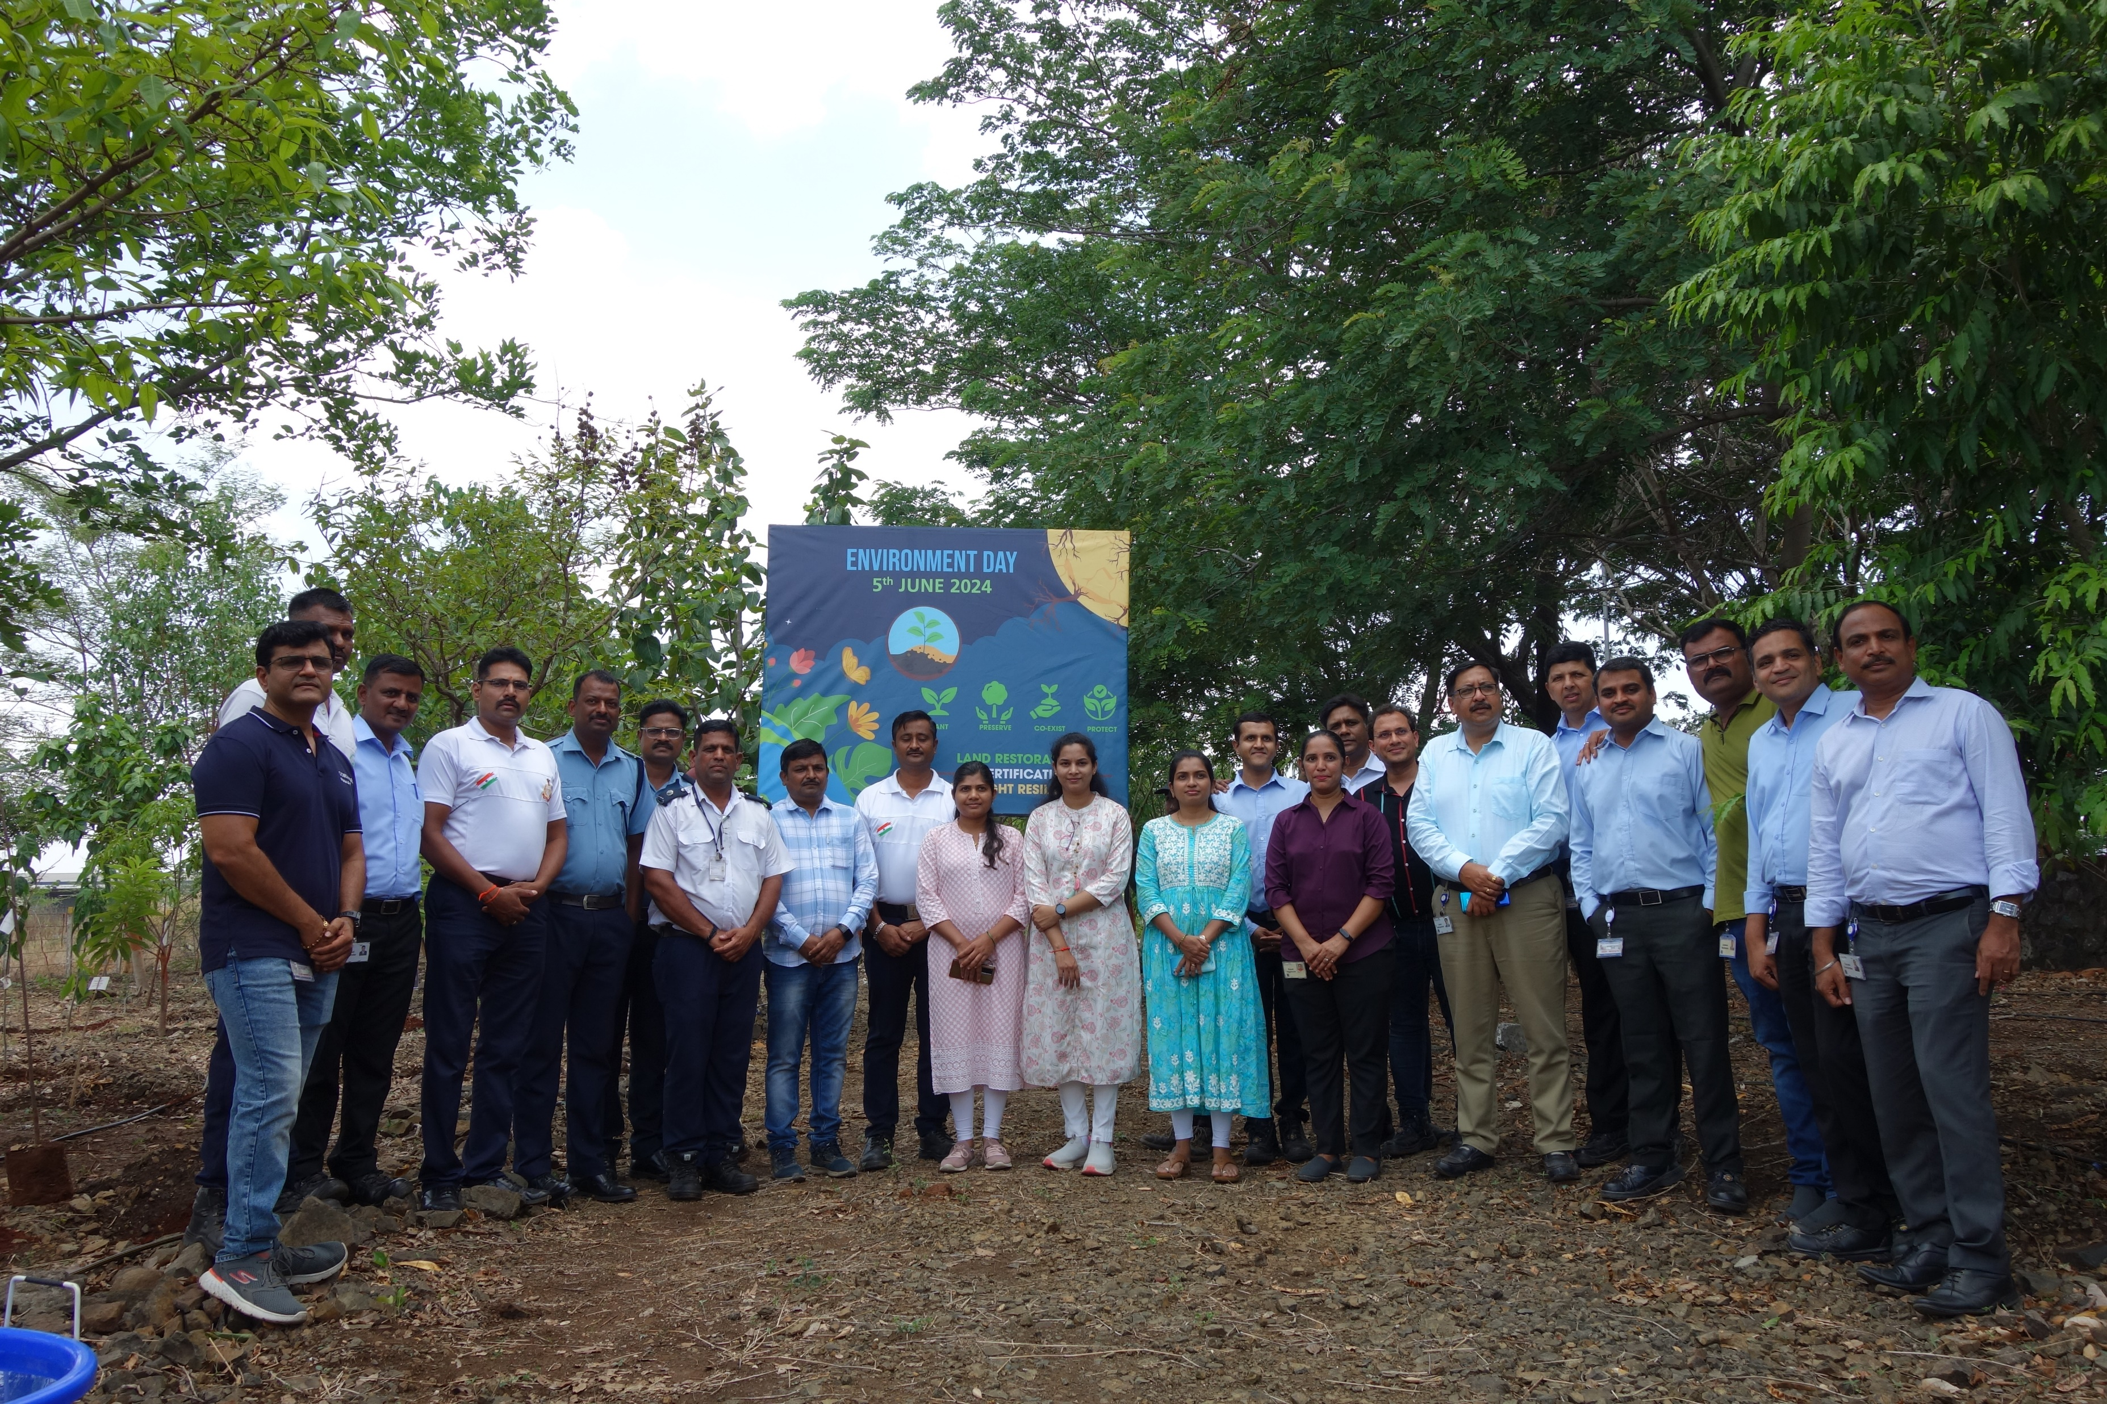
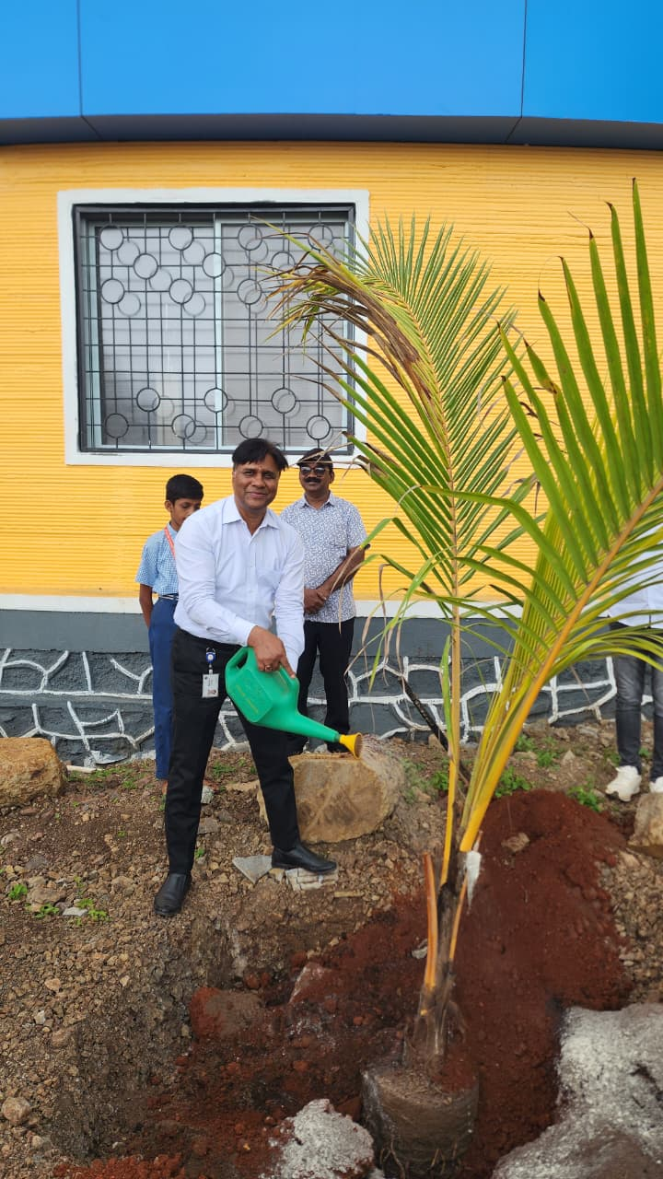
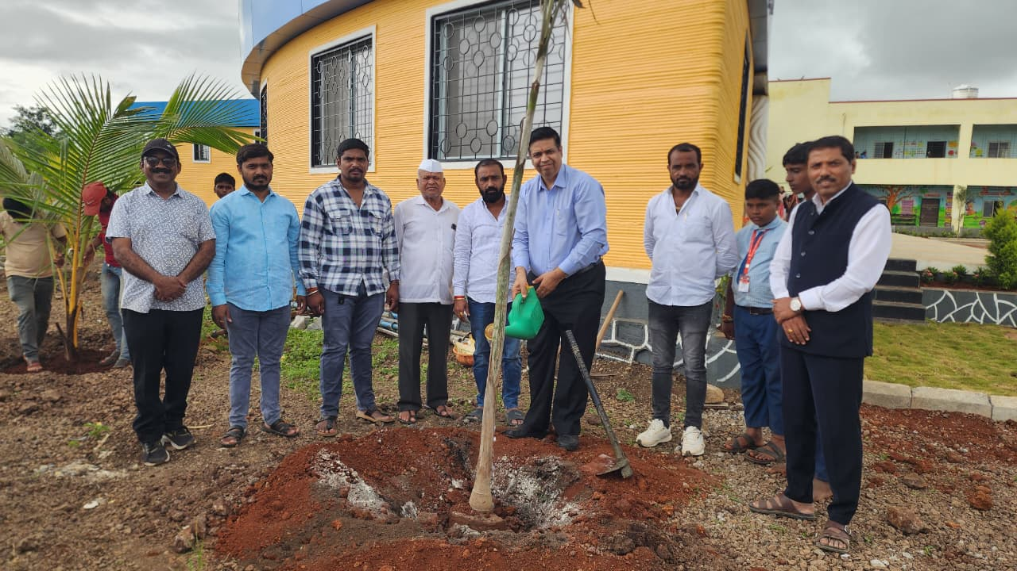
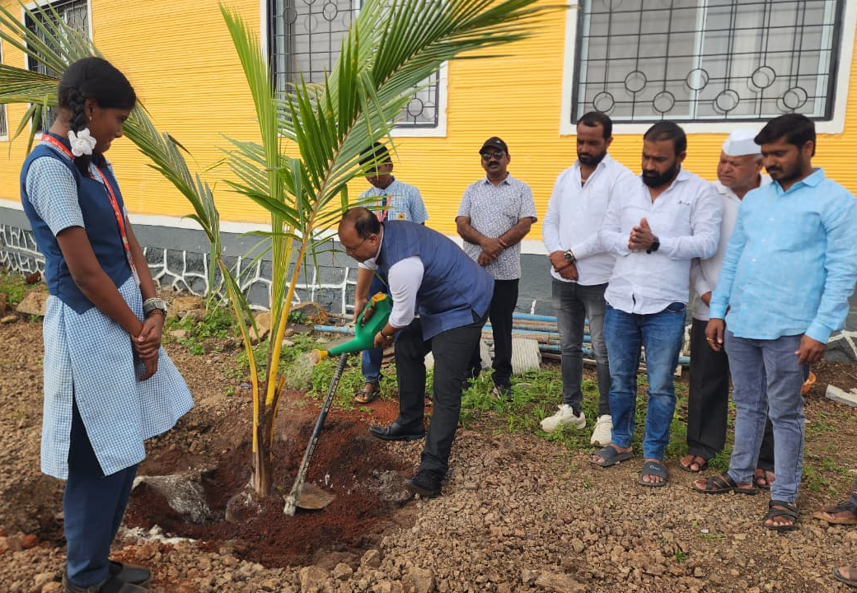
CSR- Journey 2024-2025
Emphasis on Environmental Sustainability.
Tree plantation with society initiative
Scope: Tree plantation drive involving MIDC Fire officials and society at large
World Environment Day celebration in collaboration with the local Maharashtra Industrial Development Corporation (MIDC), MIDC Fire office, along with our employees undertook a tree plantation drive in the east corridor adjacent to the manufacturing plant & at Ambethan School The team along with the MIDC authorities and Ambethan school committee planted over 70 trees across the East wing corridor boundary and around school periphery building.
Year of Work: 2024-25
Spent Amount INR =6,30,050

Slide 6
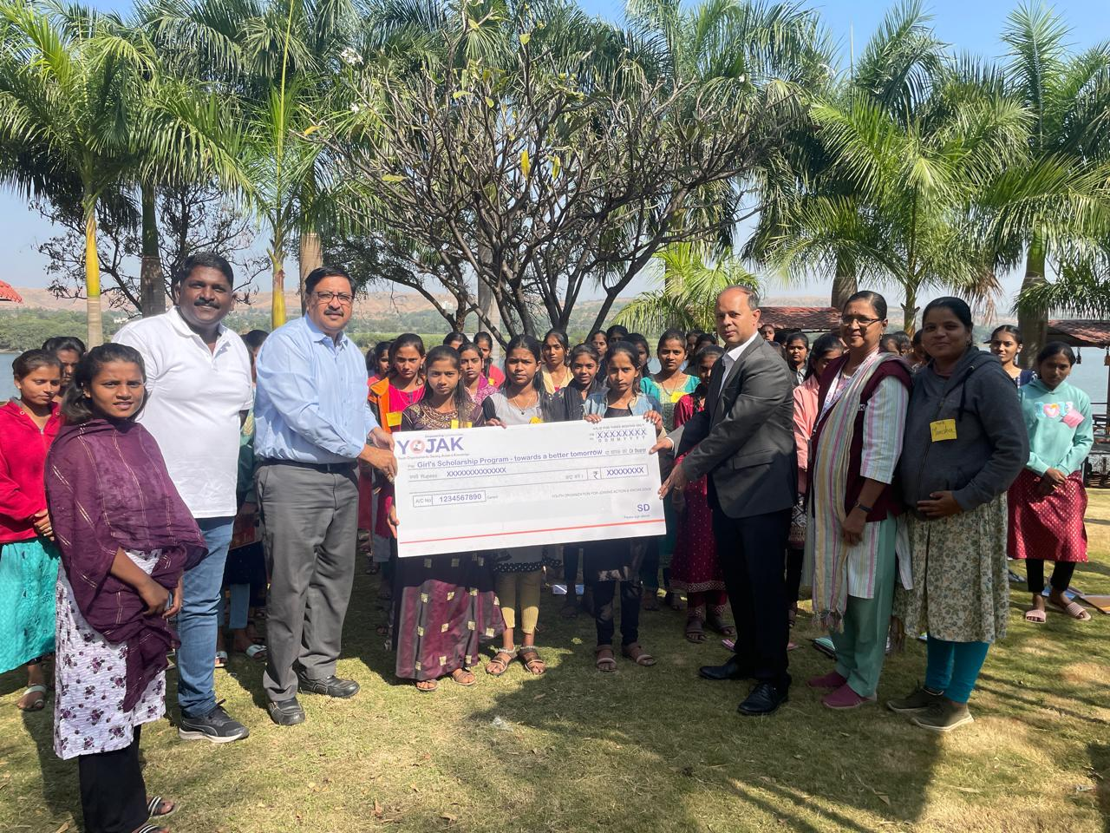
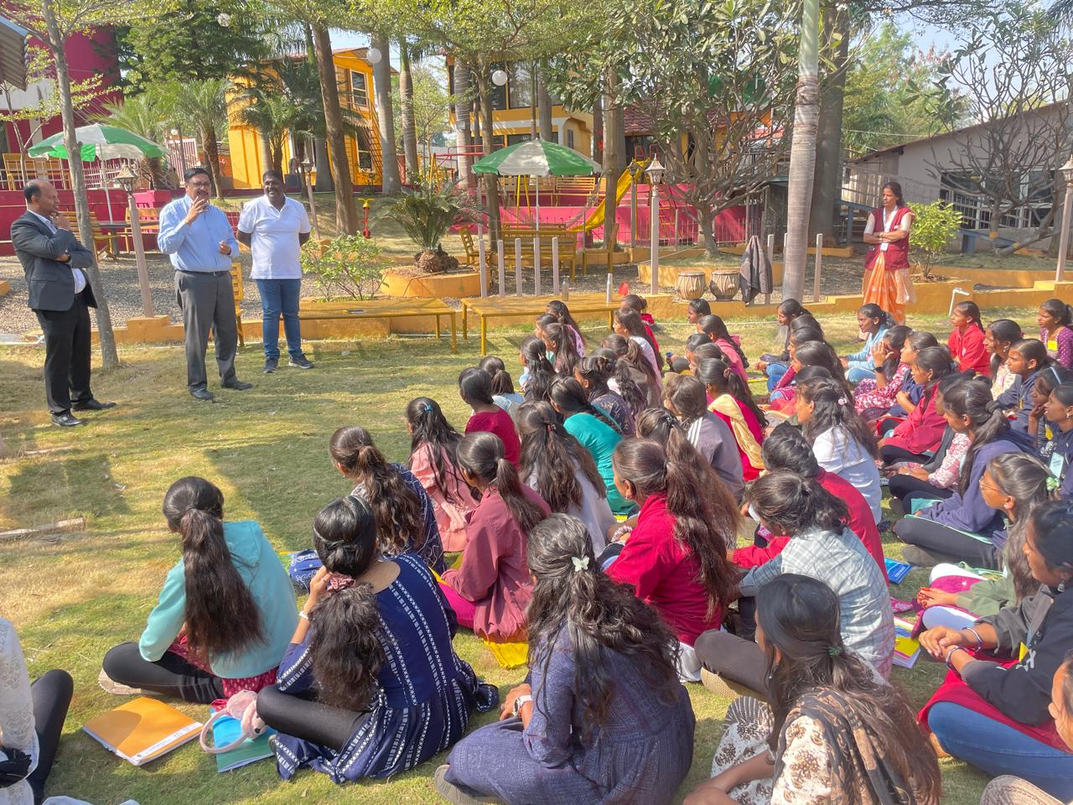
CSR- Journey 2024-2025
Emphasis on Education
Girls Scholarship Program for neighboring village Girls
Scope: Provide Scholarship support for 100 students.
Financial assistance
  School/ college fees
  Travel pass, school uniform and stationery costs.
  Technical support class (Skill, Language Etc.)
Stakeholder Information: Industries in MIDC (Chakan) have formed informal group named -“Khed collective” to support this initiative in partnership with NGO-YOJAK. Participating companies will fund the scholarship while markup cost (admin cost of NGO partner-Yojak) will be paid by Forbes Marshall, lead company for this initiative
Year of Work: June , 2024-25
Spent Amount INR = 814200
Girls' scholarship program kick off

Slide 7
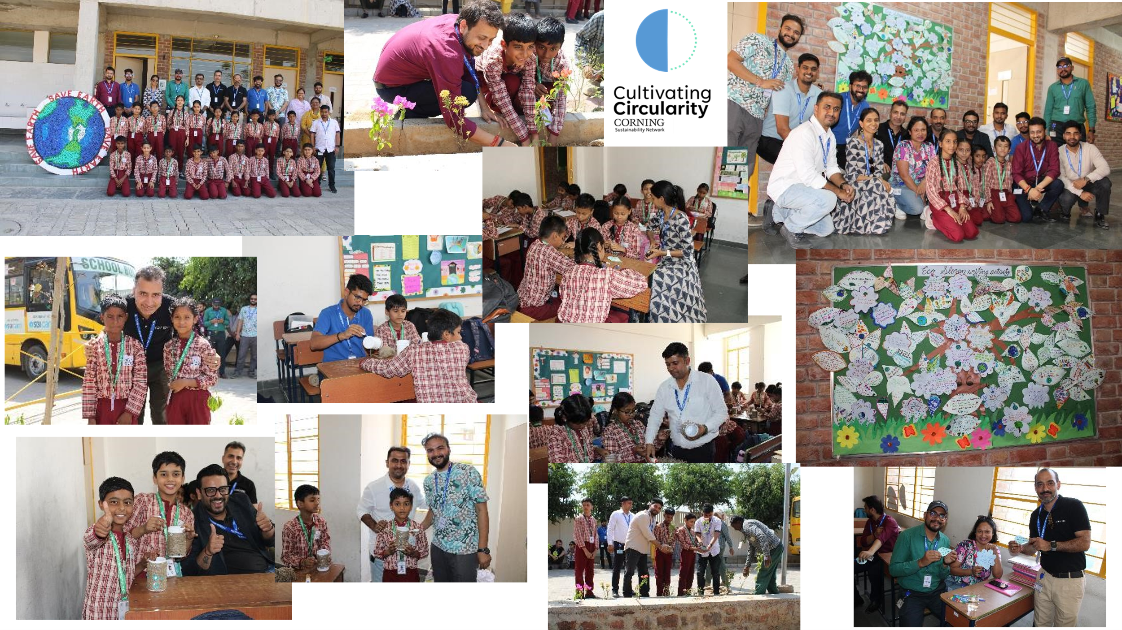
CSR- Journey 2024-2025
Emphasis on Education
Girls Scholarship Program for neighboring village Girls
Scope: Provide Scholarship support for 10 Lotus Petals students.
Financial assistance
  School/ college fees
  Travel pass, school uniform and stationery costs.
  Technical support class (Skill, Language Etc.)
Stakeholder Information: Lotus Petal Sr. Secondary School (LPSSS) has successfully completed Phase 1 with three operational buildings. J Block is dedicated to skill development and vocational training, while K Block houses the kitchen and dining facilities for nutritious meals. P Block serves as the academic hub with classrooms and administrative offices. The school also offers a sustainable learning environment with STEAM Labs and practical exposure to environmental initiatives. LPSSS aims to improve learning outcomes through quality NCERT-based education and a strong foundation for underprivileged children. Its approach combines academics with overall child development, supported by counselling, fitness, art, and theatre..
Year of Work: June , 2024-25
Spent Amount INR = 10,00,000
Girls' scholarship program kick off

Slide 8
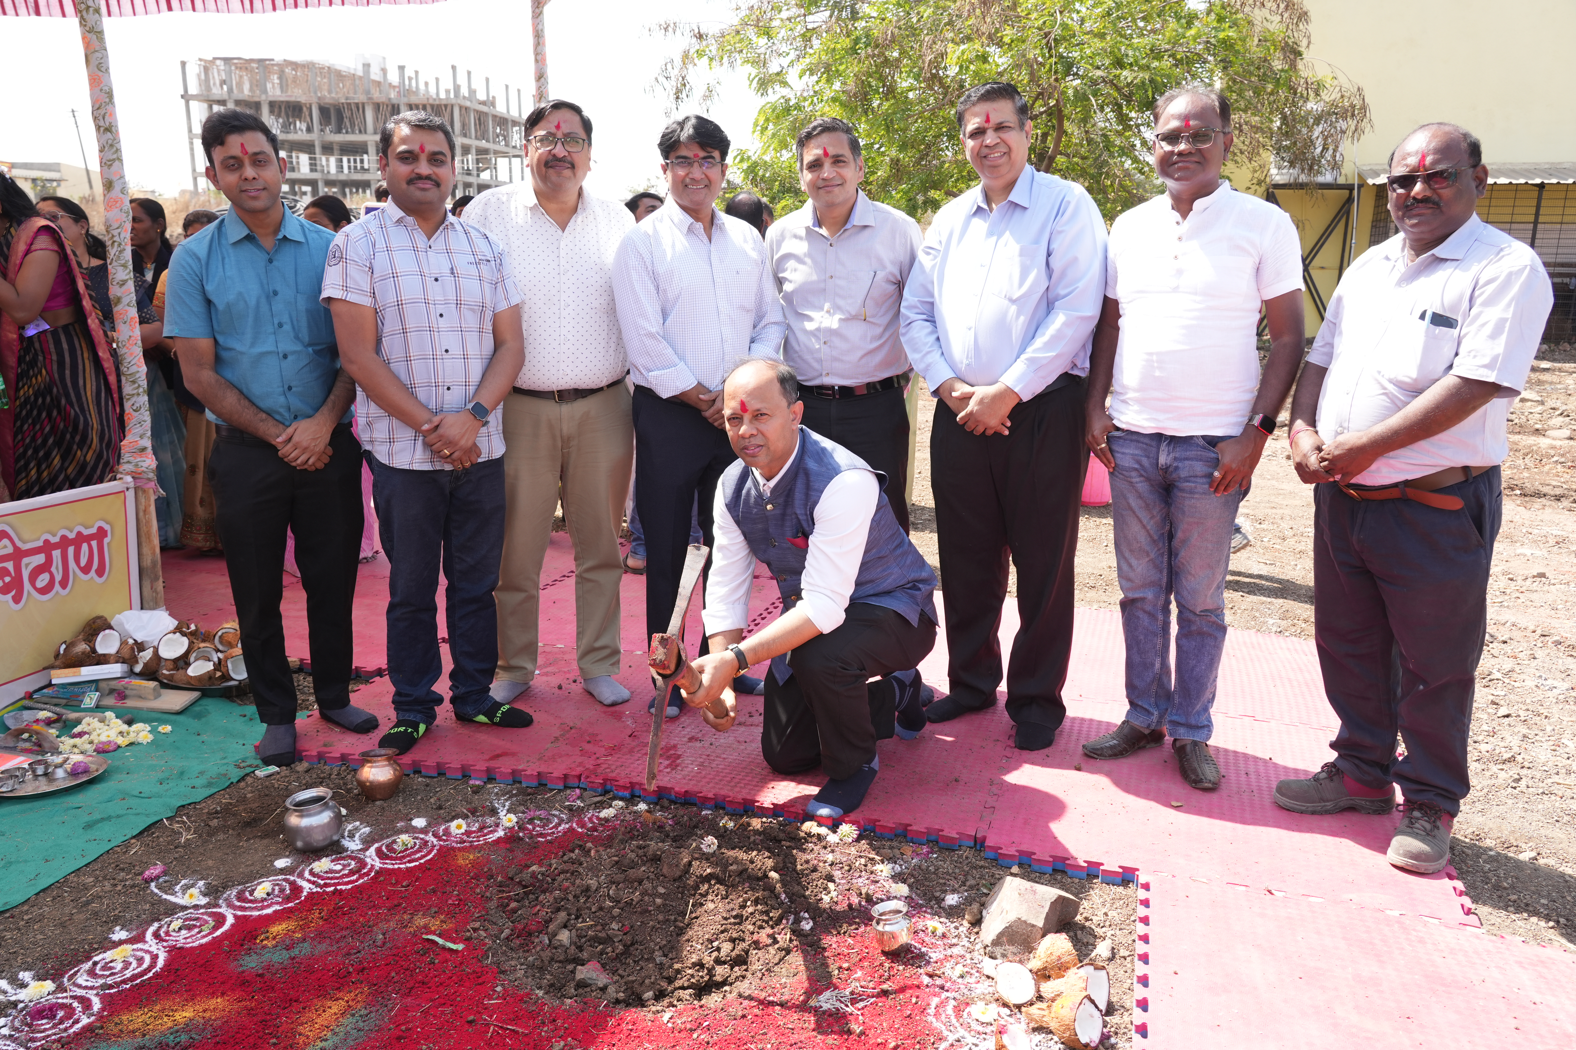
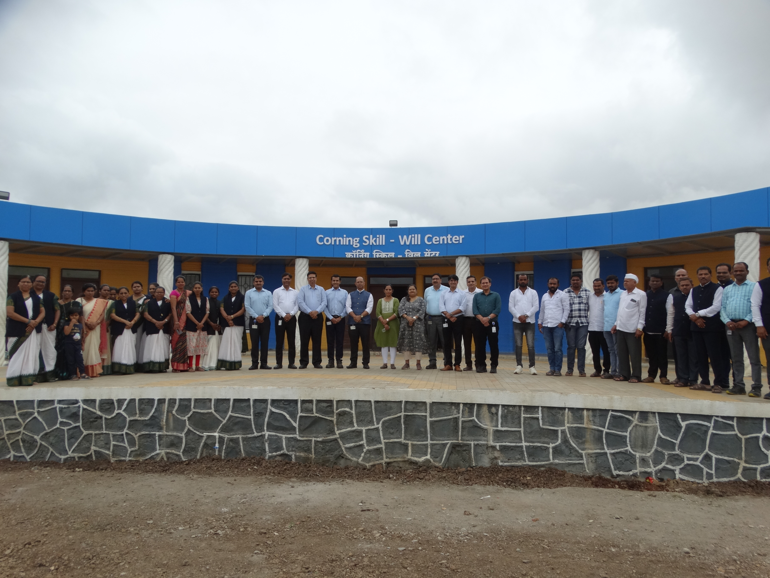
CSR- Journey 2024-2025
Emphasis on education (Infrastructure& Beneficiaries)
Zillah Parishad School Ambethan-Skill Will center
Scope: School Skill Will center for capacity building expansion with additional sitting capacity of 160 Students (Excluding Furniture Painting & Equipment's)
In 2025, Corning India pioneered 3D printing technology to create the Corning Skill Will Center at Ambethan Zila Parishad School (Local Government School). Completed in just 67 days, it is one of the state’s first 3D-printed schools, symbolizing our commitment to future-ready education.
This milestone is part of Corning’s decade-long partnership with Ambethan Gram Panchayat, where initiatives in education, clean water, sanitation, and environmental sustainability have steadily improved community life since 2012.
Year of Work: 2024-25
Spent Amount INR =1,59,90,000
School infrastructure for Zhila Parisha School @ Ambethan

Slide 9
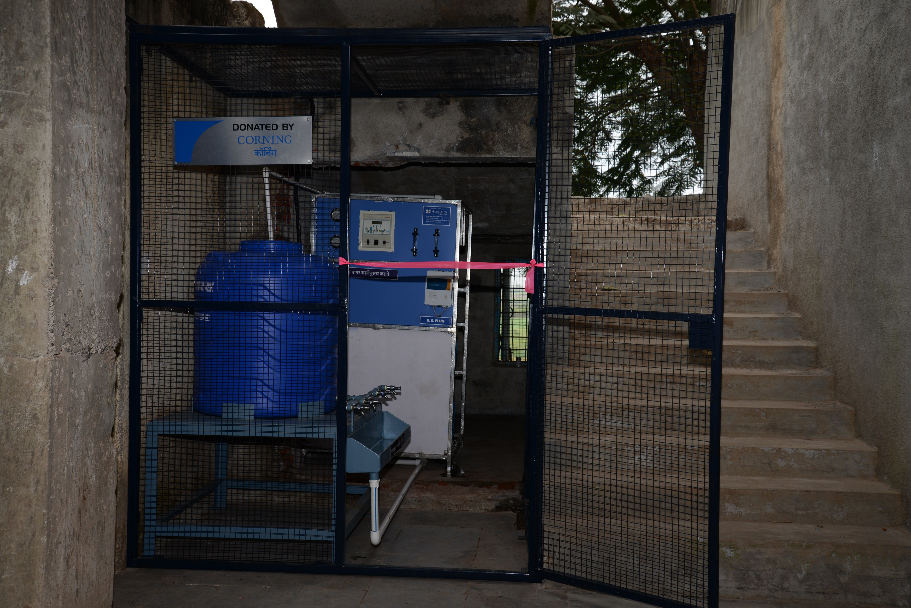
CSR- Journey 2024-2025
Emphasis on education (Girls Scholarship Program)
Water Infrastructure AMC at Biradwadi, Varale and Solban School
Scope: Provide Clean drinking water facility for Varale school and Solban school with AMC cost of Birdawadi and Ambethan
Stakeholder Information: Both the schools are located in and around of Corning plant. And we have worked with them in past and was in our list to do actions for CSR initiative. The clean drinking facility has worked well for the students and further maintenance of the plant for the period of 1 Year would be covered.
Year of Work: June , 2024-25
Spent Amount INR = 2,19,521
Clean drinking facility for Biradwadi ,Ambethan ,Varale & solban school

Slide 10


