Slide 1
Table of Contents
Registration and Login | 2
Design Area Configuration: General | 5
Cabinet: General | 8
Build: General | 14
Location | 17
Tap/Tether | 18
Preterm Lateral | 19
Splice Planning | 20
Additional Components | 24
Component Summary | 25
Messages | 26
Specification Tree | 28
Print Build Plans | 30
Saving and Closing | 32
Account Management | 33
Creating Accounts | 38
Labels | 39
Notes:
This is a video tutorial for the Corning Optical Communications’s Fiber-to-the-Home Configurator.
In this video we will explain how to easily design and order a complete fiber to the home network.
Specifically, we will cover how to choose your architecture, configure your cable, splice plan, and create a Bill-of-Materials with pricing etc.

Slide 2
Registration and Login
To have access to the configurator, please talk to your sales representative and they will submit a ticket to get you registered.
Once your account has been set up, you will receive an email with your login information and administrative rights.
From there, you will be able to register other employees from your company.
Notes:
Registration and login is required to use the configurator.

Slide 3
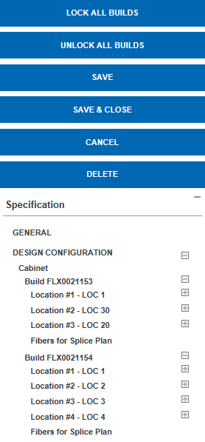
General
Design area information and default cable selection
Design Configuration
Product selection and configuration
Cabinet
Add builds and the option to select Cabinet, Splitter, and Closure
Splitter
Closure
Build
FlexNAP™ Assembly configuration
Location
Tap/Tether
Multiport
Drop
Notes:
Before we dive into the instructions, we would like to explain the big picture of how the new configurator works. When you begin to build a Design area, you will first fill out the information under the “General” tab. Here, you will enter information such as the description and location of the Design area. You will also enter your default cable selections. This means that you will fill out information about your cable type under this tab and your entries will then carry through to your builds. You are able to make changes at the build level. But, to save time, it is best to enter the most common cable information at this General level.
After you fill out the General tab, you will move to the design configuration portion. In this section you will be able to add products to the Design area and will begin the configuration process.
Beneath the design configuration tab is the Cabinet tab. This section will allow you to add cabinets, splitters, and closures to your design area. This is also where you add your builds.
If you choose to add additional components in this section, they will appear in tabs beneath the Cabinet section.
When you add builds, they will also appear in tabs below the cabinet section. At the build level to you will be able to make or change cable selections and do your FlexNAP Assembly configuration, which includes adding locations to your build.
When you add locations, they will appear beneath the build tab, and you will then enter the span distances and have the opportunities to add tethers to the locations.
If a tether is added, a tab titled “Tap” will appear beneath the location tab. If you expand that tab, tabs will show up with the tethers
At the tether level you are able to add multiports and drops. If they are added they will appear in a tab below and so on…
Through the configuration process, there will be a navigation tree on the right hand side of the screen. As you add builds and locations and components to the design area, they will appear in the navigation tree. All of these parts on the navigation tree are links and if you need to navigate to a certain part of the design area, you can click the link and it will bring you to that tab.

Slide 4
Important Note: All options may vary based on contract and design type. Your screen may not be identical to the screenshots used in this document.

Slide 5
1. Design Areas: Choose appropriate Design Area from top of the page. Design Area options may vary based on contract.
Notes:
To begin the configuration process, you will have to select your design area. If you only design one way, there may only be one option.
If you are choosing between design types, it is important to note the following:
A centralized design area means there is a single LCP and splitter location.
A Distributed design area will have two splitter locations.
A Hybrid design area will be combination of the two areas above and enables the combination of OptiTip and OptiTap connectivity technology.

Slide 6
Reminder: These images may not match your screen based on customer and previous selections.
Design Area
Description: Provide a description of the design area you are building. For tracking purposes, keeping this information unique for each FlexNAP™ cable designed is recommended.
Country, State/Region, City: Provide the geographical information for the design.
Project ID: Provide the project or work order number for the FlexNAP build being designed. This information will print on the paperwork which ships with each FlexNAP cable and will be printed on labels attached to the FlexNAP cable ends and access points.
Environment type: Select what type of environment this build will be deployed in. Options are: Outdoor; Indoor
5. Installation type: This drop-down menu automatically populates with choices based on environment type.
Outdoor Installation Types
Aerial | Cables that will be installed in aerial applications (overlash or dedicated messenger).
Below Grade-Duct | Cables that will be installed in buried duct applications (1.25-in or >1.25-in duct capable).
Below Grade-Buried | Cables that will be installed in direct buried applications (trenching, plowing, missile bore, etc.) or in 2-in duct or larger.
Aerial-Duct | Cables that will be installed in an aerial-duct applications.
Self-Supporting | Figure-8 cables with an attached messenger wire.
Indoor Installation Types
Duct | Cables that will be installed in ISP riser environments.
Tray | Cables that will be installed in ISP riser environments.
Notes:
First, we will enter the “General” portion of the Design area.
In the description field you will enter whatever description you would like. This is for your use only and will not be printed on any paperwork.
You will then enter the location information.
Project ID: Provide the project or work order number for the FlexNAP™ build being designed. This information will print on the paperwork which ships with each FlexNAP™ cable and will be printed on labels attached to the FlexNAP™ cable ends and access points.
Environment type: Select what type of environment this build will be deployed in. The options are Outdoor or Indoor. Most of you will be using the outdoor option.
Installation type: The drop-down menu automatically populates with choices based on environment type. If you selected an outdoor environment, your installation type choices will be aerial, below grade duct, below grade buried, aerial-duct, and self supporting. If you selected an indoor installation type, your choices will be duct or tray.

Slide 7
These fields can be filled out at the global level (current general field) or can be filled out at the individual build level. All asterisks are present.
Design Area
9. Fiber mode type: If the environment type is outdoors, this field will automatically populate to “Single-Mode OS2”. If the environment type is indoors, the choices are: Single-Mode OS2 , 50 µm multimode OM3
10. Buffer-tube Fill type: Select what buffer-tube fill type is needed. Depending on the previous choices made, this may be automatically generated. All possible options are: Gel-Free and Gel-Filled. Gel-filled is only offered on figure-8 cable type.
11. Flame retardant type: This will only become an option when an indoor environment is chosen.
12. Support type: Select whether or not self-supporting option is needed . Our self-supporting option is our figure-8 cable.
13. Toneable type: Select “Yes” if you would like toneable.
6. Duct size: This field will only become available if “Below Grade-Duct” or “Indoor Duct” is chosen as the installation type. The options for duct size are: 1.25-in, >1.25 –in. This refers to inner diameter of the duct.
7. Armor type: Select if armored cable is needed. If it is needed, select “Single”. If no armor is needed, select “N/A”. Only armored option is single jacket, single armor.
8. Cable type: The options in this field will change based on the environment and installation type chosen. The options are: Loose Tube, RPX® Ribbon.
1.25 in
> 1.25in
Loose Tube
RPX® Ribbon

Slide 8
Design Area
14. Build fiber assignment method: Select your fiber assignment method. Options are: High to Low, CO to Field; High to Low, Field to CO; Low to High, CO to Field; Low to High, Field to CO; Best Fit (see table right)
15. Length unit measure: Should automatically populate to “Feet” or “Meters” based on customer
16. Contract customer - for internal customer use
Build fiber assignment methods
High to Low, CO to Field | Spares: lowest fiber counts Assigned Fibers: CO side higher-fiber counts, field side lower-fiber counts
High to Low, Field to CO | Spares: lowest fiber counts Assigned Fibers: CO side lower-fiber counts, field side higher-fiber counts
Low to High, CO to Field | Spares: highest fiber counts Assigned Fibers: CO side lower-fiber counts, field side higher-fiber counts
Low to High, Field to CO | Spares: highest fiber counts Assigned fibers: CO side higher-fiber counts, field side lower-fiber counts
Best Fit | Fiber assignment based on ease of manufacturing
Notes:
The build fiber assignment method will dictate how your splice plan is done. The options are: High to Low CO to Field, High to Low Field to CO, Low to high CO to field, Low to high Field to CO, and best fit. This will determine where your spare fibers will be located.
For reference, please see bubble number 15. This field will automatically populate to feet or meters based on your contract.
For reference, please see bubble number 16. This field will automatically populate based on whether or not your company has a contract

Slide 9
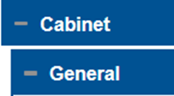
1. Design Configuration: Select this box and you should see two boxes drop-down; Cabinet and Additional Components. Select the “Cabinet” tab to continue.
4. How many builds do you want to add to your design?- Type in this field the number of builds that are being added to this design. Enter this value as a numerical figure (1,2,3 etc)
5. Add a build at a specific position in the cabinet: This will enable you to add a build to a specific location.
2. Cabinet Catalog number: This item is optional. If the catalog number is known, choose from the drop-down menu.
3. Do you want to add a cabinet to your design?:
Selection options: Yes; No. If planning to purchase a cabinet with design, select Yes. Otherwise select, No- just a placeholder.
6. Would you like to add an additional splitter?: To add additional capacity, multiple splitters are often needed in the cabinet. Select “Yes” to add an additional splitter. If choose “Yes”, reference page 12.
7. Would you like to add a closure to your design?: If choose yes, reference page 13
Notes:
Now you will enter into the design configuration portion of your design area. After expanding that tab, you will enter into the cabinet configuration tab.
For reference, please see bubble 2. If you would like to add a cabinet to the design area, you must know the part number. The cabinet is NOT configurable at this time.
For reference, please see bubble 3. When you are asked: Do you want to add a cabinet to your design?, you can select ‘no- just a placeholder’ if you are not planning to purchase a cabinet.
Due to the complexity of how customers splice to their cabinets, we are still conducting voice of customer to make this a better user experience. Therefore, at this time, customers are required to validate their splice plans and product selection for the closures, cabinets, and splitters. However, customers can configure or select a catalog number to add to the bill-of-materials.
For reference, see bubble 4. Enter the number of builds you would like to add to the design area. It is important to note that you will enter the number of additional builds needed. So, if you have already entered four builds and realize your design area has five total builds, you would enter 1 into this field and not 5.
For reference bubble number 5- add a build at a specific location in the cabinet. Select the number order you would like to add the build to in the sequence.
For reference bubble number 6- Select yes if you would like to add an additional splitter to the design area

Slide 10
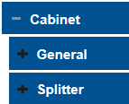
Adding a splitter to build
1. An additional “Splitter” tab will appear under the “Cabinet” tab. Select the “Splitter” tab to expand it.
6. Select the connector type for the output fibers from the drop-down menu.
2. If the part number is known, choose from the drop-down menu shown below.
7. Select the lengths for the input and output fibers for the splitter.
3. Enter item quantity into the space.
4. The environment type, connector types, and input/output leg lengths may be automatically generated based on previous suggestions. If they are not, please fill out accordingly.
4. Select the environment type from the drop-down menu.
8. Select the configuration for the splitter from the drop-down menu.
Note: The first number signifies the number of fibers going in and the second number signifies the number of fibers coming out.
5. Select the connector type for the input fiber from the drop-down menu.
9. Select “Yes” to remove the splitter from the design area.
Notes:
If an additional splitter is needed, select the part number from the drop-down menu.
The part numbers available are based on the customer contract. If the part number is not known, you can configure it in the next steps.
Read steps 3-9.

Slide 11
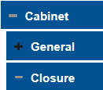
Adding a closure to build
1. An additional “Closure” tab will appear under the “Cabinet” tab. Select the “Closure” tab to expand it.
2. If the part number is known, choose from the drop-down menu shown below.
Note: While other components of the build may be configurable, the closures are not. A part number must be known to add a closure to your design area.
3. Enter item quantity into the space.
4. Select “Yes” to remove the splitter from the design area.
Select “Yes” to remove the closure from the design area.
Notes:
If adding a closure, an additional ‘Closure’ tab will appear under the ‘Cabinet’ tab. Select the ‘Closure’ tab to expand it.
If adding a closure to the design area, the part number must be known. They are NOT configurable at this time.
Select the closure part number from the drop-down menu and then enter the quantity. If you would like to delete the closure from the Design area, select ‘yes’ in step 4.

Slide 12
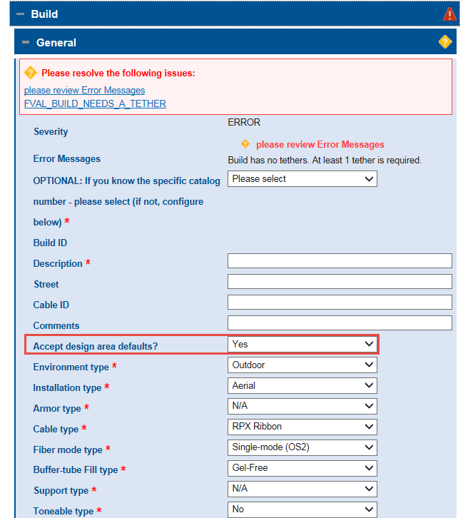
Note: When entering the build section, all boxes included in screen below may be automatically filled based on previous inputs. The selections below are for an example and may not be identical to your build. If you would not like to “Accept design area defaults” and would like to make different selections, select “No” from the drop-down menu.
8. Port Count - Number of ports associated with the cabinet selected
Leg Count - Number of output legs associated with the cabinet selected
9. Add an additional cabinet to your DA: Select if more than one cabinet is needed for this design area.
10. Autogenerate splice plan: More info on splice plan on pages 22-23.
By selecting yes, it will provide a splice plan of your FlexNAP™ builds to the cabinet legs.
Note: Do not select “Yes” until all cables are configured.
Buffer tube Fill type *
Notes:
Okay, back to the cabinet tab. If you added a cabinet to your design area, the leg count and port count should automatically generate.
The leg count refers to the number of output cables (depends on number of distribution stubs).
The port count refers how many ports are in the cabinet (cabinet size). Both of these fields are automatically generated based on cabinet selection since cabinets are not configurable at this time.
If you would like to add an additional cabinet to the Design area, you can do so in step 9.
The next step is to auto-generate the splice plan. There is more information on splice plans later in the presentation, but for now you will want to skip this step and come back to it if you wish to auto-generate your splice plan after all of your cables are configured.
Now, you will go to the build level. As mentioned before, if you previously made selections for your cable, they will be reflected in the build tab as well. Also, if you know the part number for your cable, you can choose that from the drop-down menu towards the top of the screen. Your part numbers may be limited by your previous selections.
It is important to note that general errors may come up at this level, but go away as you add tether to the build. If the errors still appear after you are done configuring the design area, you will have to re-evaluate and find out what is wrong with your design area.

Slide 13
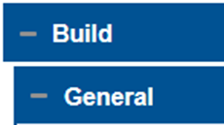
1. Fiber count: Select the fiber count of the distribution cable
5. CO Slack: the amount of slack requested on the wire center side (Central Office, Headend, Hub, etc.) end of the FlexNAP™ System cable. This field defaults to a minimum 50 ft.(15.24m) and can be overridden by the user. This slack is typically used for splicing the FlexNAP System cable into the Hub or Main Distribution network. This number can be changed to greater than 50 ft, but not less than.
6. Field Slack: the amount of slack requested on the Field End of the FlexNA System cable. This field defaults to 15 ft. (4.572 m) for Aerial/Tray and 25 ft. (5m) for Buried/Duct. This is the minimum amount of slack required on the Field End of the cable. This field can be overridden to accept longer lengths. This number can be changed to greater than 15 ft, but not less than.
7. Preterm type: Select “CO-side” or none. If more information is needed, please contact your sales person.
2. TAP type: Select what kind of TAP will be used. TAP types available are: Overmold, Heat-shrink, Overmold (RPX®)
3. Build fiber assignment method: Fiber assignment methods available are: High to Low, CO to Field; Low to High, Field to CO.
4. How many locations or additional locations do you want to add?: Enter the number of locations (poles, pedistals, handholes) that will be used in this build. This needs to be entered as a numerical value.
Overmold
Heatshrink
Overmold® RPX
Note: Reference page10 for more info on fiber assignment methods.
Notes:
The first field that will not be filled out based on previous choices is fiber count. If you chose a part number at the top of the screen, the fiber count will be automatically generated based on that part number.
TAP type: Select what kind of TAP will be used. TAP types available are: Overmold, Heatshrink, and Overmold RPX®.
When choosing a TAP type, please contact your Corning representative if you are unsure of the selection. This field is customer specific depending on the cable type being used.
For the Build fiber assignment method, number 3, please reference page 8 for more information.
For reference bubble number 4, you will need to know how many locations or additional locations you want to add. Enter the number of locations that will be used in this build. This needs to be entered as the number of additional locations needed, just like when entering the number of builds.
Read steps 5 and 6.
7. If you have preterm laterals on your contract, you can choose CO-side if you would like to add a preterm lateral to this build. If you do not currently design with preterm laterals, leave this field as ‘please select’ or ‘none.’

Slide 14
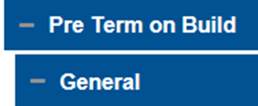
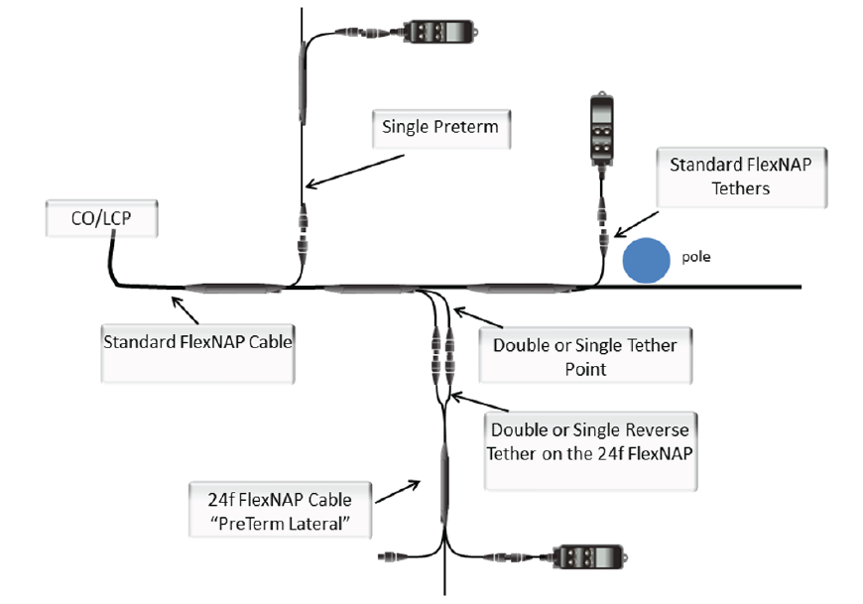
Preterm on Build
Preterm Lateral
Preterm Lateral: A preterm lateral is a way to connect an additional FlexNAP™ cable to service a side street or cul-de-sac. Pinless OptiTip® connectors are used to break off the main path without having to splice in the additional cable.
7. Furcation type for a preterm lateral should be automatically generated. This means that the lateral has the tensile strength listed.
4. Select Preterm on Build tab and then General tab
8. Select leg type. This is automatically generated.
Preterm on Build
5. If the part number is known, select from the drop-down menu.
6. Select the type of connector being used for the preterm lateral (12 or 24 fibers)
Notes:
If you selected CO-side in the previous field, a tab called ‘Preterm on Build’ will appear beneath the build. You can select the part number if it is known, otherwise the type of connector chosen will generate the part number.
Furcation type and leg type will be automatically generated.

Slide 15
8. How many fibers do you want to express?- This is referring to the fibers that will not be used during this distribution network but will be saved for downstream use.
9. Start express fiber number: This is referring to the number of the first fiber that will be expressed. It will be assumed that all fibers after this number will be expressed.
Note: See page 23 for splice plan information
11. Cable length- The current cable length based on all entries in build configuration.
12. Delete build: Select “Yes” to remove build from design area
10. Maximum allowable cable length: This is automatically generated based on cable type and reel capacity.
Notes:
Start express fiber:
If express fibers are not needed in the network, this field will automatically default to the number 1 greater than the cable fiber count.
If express fibers are needed, enter the number of the first fiber number you would like to express. For example, if you enter 12 express fibers and start at 1, it will express fibers 1-12.
We are going to skip the splice plan for now. We will get to that on page 21.

Slide 16
Location sequence: Automatically generated by configurator
2. Location ID: The name of the pole/handhole/pedestal as shown on the design area. User-generated data field that will be printed on tether labels.
3. Span-distance to next location: The distance between locations. The unit of measure will be consistent with the “length unit measure” selected under the general tab.
4. Slack storage: The additional slack footage that will be stored at this location. This will be located on the field side of the location. This will be designated by yellow stickers on the cable.
5. Sag adder: the distance (no longer percentage based) of sag that will be added to the span distance specified in aerial applications. The sag will be added to the value of the span, entered above. We do not recommend changing this value unless it is necessary. (Best practice is to leave this as 0)
6. Number of tethers at this location: Use the drop-down menu to select the number of tethers that will be needed at this location. If not adding tethers to the location, leave the field as “Please select”.
7. Position to move this location to: This will enable you to move the location to a specific location sequence.
8. Delete location: Select “YES” to delete the location created.
Note: This will automatically generate to 0.0 on the final location of the build. If the final location is deleted, you will have to change the new final location to 0.0.
Notes:
Now, we will go into the location tab. Whenever locations are added to the build, location tabs will appear beneath the build. You will want to expand that tab and then expand the general tab to enter your location information.
Read steps 2 through 6.
7. If this location is not in the right sequence, select the new location sequence from the drop-down menu. This will then push every location following the current one up one location number (+1).
Read step 8.

Slide 17
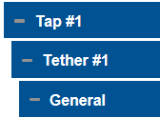
1. Catalog Number (BEST PRACTICE): If you know the part number, select from drop-down below. If this number is not known, configure below.
5. Add a multiport: Select whether or not you would like to add a multiport to this build. This will add the multiport to the final build of materials for the design area.
Do you want to add a multiport?
2. Tether fiber count: The number of fibers assigned to this tether
6. Leg length and UOM: length of the tether
3. Tether type: Select tether type from drop-down menu
ft
7. Preterm lateral: Details in next slide
4. Loop back: COC offers a loopback device contained within the OptiTip® MT dust cap. The loop back allows a user to test the FlexNAP™ system cable for continuity after installation and prior to terminal assemblies being installed at the network access point (NAP) locations. If a loop back is desired at a NAP location, select “Yes” in the loop back field.
Preterm Lateral: A preterm lateral is a way to connect an additional FlexNAP cable to service a side street or cul-de-sac.
Pinless OptiTip® connectors are used to break off the main path without having to splice in the additional cable.
Notes:
If you added any tethers to the build, they will appear beneath the tap tab.
For reference bubble number 1: If the part number for the tether is known, select it from the drop-down menu. If this number is not known, you can configure it below.
For reference bubble number 2: Select the number of fibers assigned to this tether
For reference bubble number 3: Select the tether type from the drop-down menu.
Read steps 4-6.
For reference bubble number 6: This is the length and unit of measure for the tether. This will be automatically generated.

Slide 18
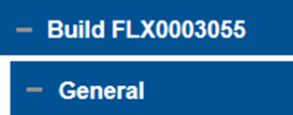
Splice Plan
Note: Do not select “Yes” for splice planning until entire cable is configured.
3. A tab will then appear that says “Fibers for Splice Plan”. Select this tab to continue with splice plan.
1. Splice Plan- If splice plan generation is needed, navigate back to General tab for the FlexNAP™ cable (under “Build ID” Ex. FLX0003055) and scroll down to “Start Splice Planning” and select Yes.
Next- To Autogenerate splice plan for a particular cable build, select “YES” if you would like to manually do the splice plan, select “NO”
Notes:
Once all of your locations and tethers are complete for the build you will navigate back up to the build level and start your splice plan.
To begin splice planning, you first need the choose Yes in the start splice planning field. Then, if you would like to auto-generate, or have the system assign the fibers for you, select Yes in the auto-generate splice plan field. If you would like to do your splice plan manually, select No.
A tab will then appear that says ‘Fibers for Splice Plan’. Select this tab to continue with splice plan.

Slide 19
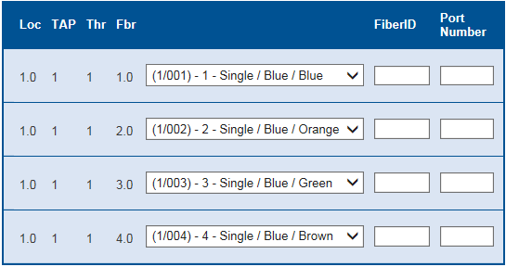
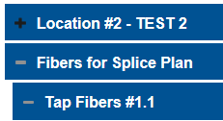
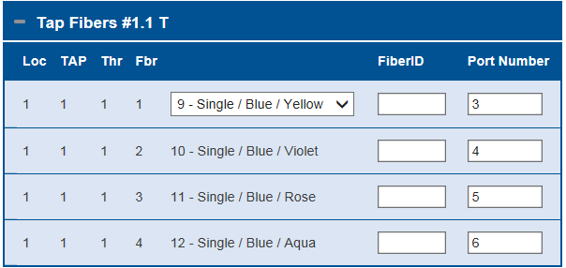
Autogenerated (Best Practice)
1. When splice plan is generated, the fibers will be organized by tap.
2. Fiber assignment will be automatically generated based on previous selection for fiber assignment method. Enter Port Number and FiberID based on design.
Note: If a cabinet is being selected, the autogenerated splice plan will generate the port numbers. (shown below)
Note: The FiberID will print on the build plans. This can be named anything including numerics and letters.
Notes:
Select the ‘Fibers for Splice Plan’ tab and then select the ‘Tap Fibers’ tab. When auto-generating the splice plan, all of the fibers should be assigned based on your previously selected fiber assignment method. If you have selected a cabinet, you can enter in the first port number and then the rest will be automatically generated. The first and last port numbers for the tether will be printed on the tether label. The FiberID will need to be entered manually and is not required. The Fiber ID will print on the build plans and can be named anything including numbers and letters.

Slide 20
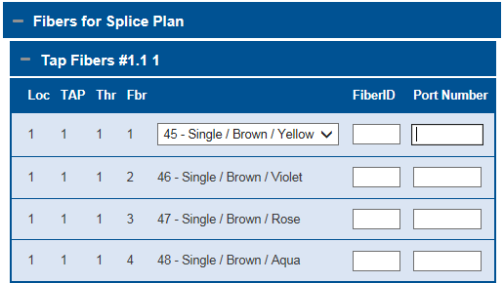
Manual Splice Plan (High-to-Low Selection)
Select the Tap Fibers tab, and the number of fibers chosen per tap will appear below with everything else blank.
Enter the Fiber IDs and Port Numbers manually for each fiber.
Note: The Fiber ID will print on the paperwork. This can be named anything including numbers and letters/
Select the fiber assignment for the first fiber listed, and the rest should automatically generate.
Notes:
If you did not choose to auto-generate the splice plan and are doing it manually, the process will be a little bit different.
If you have chosen a high-to-low or low-to-high fiber assignment method, you will only need to assign the first fiber, and then the rest should automatically populate. The Fiber IDs and port numbers will need to be entered manually for each fiber.

Slide 21
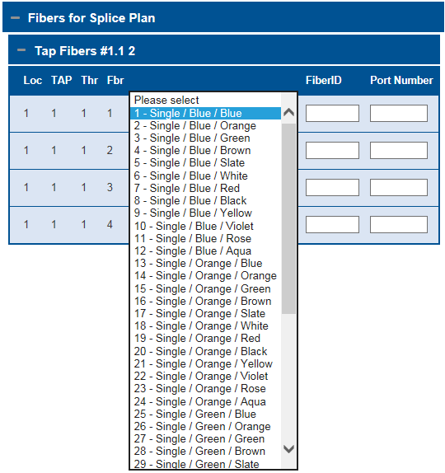
Manual Splice Plan (Best Fit)
1. Select the “Tap Fibers” tab.
2. Select the fiber assignment (i.e. Single/Blue/Blue) for each fiber.
3. All port numbers and Fiber IDs will need to be entered individually.
Fiber ID
Note: The Fiber ID will print on the paperwork. This can be named anything including numerics and letters.
Notes:
If you chose ‘Best Fit’ for your fiber assignment method and are doing it manually then you will have to manually assign each fiber, along with their port numbers and FiberIDs.

Slide 22
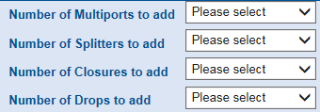
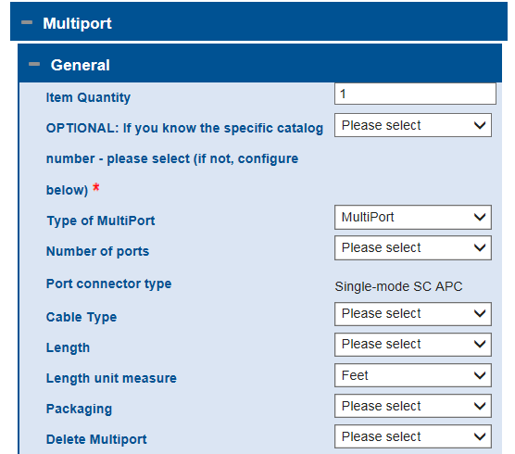
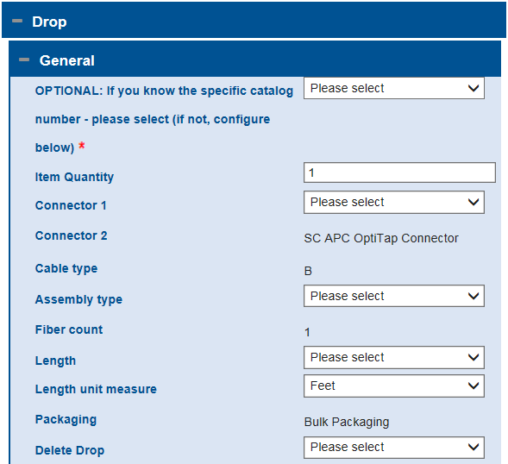
1. Additional Components: Choose from the appropriate drop-down menus to add additional components to the BOM.
If a Multiport is added:
If a Drop is added:
SC APC OptiTap® connector
Notes:
The next tab you will see is ‘Additional Components.’ In this section, you are able to add additional MultiPorts, Splitters, Closures and Drops to your design area.
MultiPorts, Splitters, and Drops are all configurable. Closures are not.

Slide 23
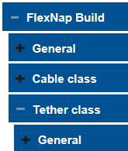
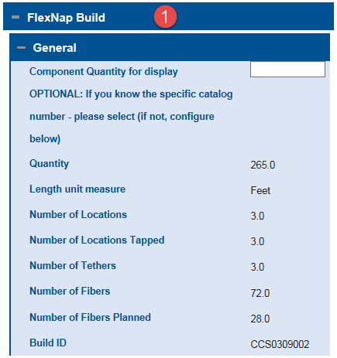
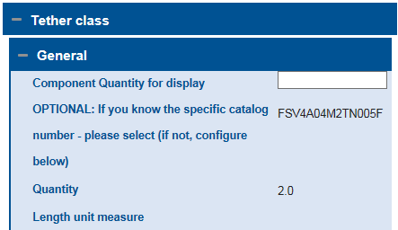
1. Below Component Summary, click the “FlexNAP™ Build” tab and then the “General” tab to view/validate the part number and details of the FlexNAP build created.
Below “FlexNAP Build” will be more details about cables and tethers added to the design area. Continue to expand the tabs to view cable/tether information.
FlexNAP Build
Component Quantity for display
OPTIONAL: If you know the specific catalog
number- please select (if not, configure
below)
Expanded:
Length unit measure
Number of locations
Number of locations tapped
Number of tethers
Number of fibers
Number of fibers planned
Build ID
If other components are added to the build, they will appear in the component summary as well, and can be expanded for more details.
Notes:
Once your design area is configured, you can choose the ‘Component Summary’ tab to view a summary of your design area. Once the component summary tab is chosen, you can expand the details of the build. If the FlexNAP build is chosen, it will then expand and you should be able to view the details of your FlexNAP cable (length, number of tethers, fibers etc.)

Slide 24
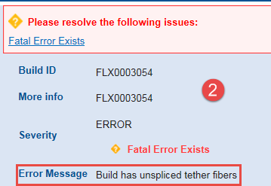
1. If there is an error in the build, it will appear in the “Messages” tab.
Note: See page 30 for possible messages.
2. When the “Error” tab is expanded, the Error Message will appear at the bottom of the tab. These errors will need to be corrected to complete the design area.
Notes:
If you receive an error message, it will appear in a ‘Messages’ tab at the bottom of the screen. The error message may also appear in the build area, but if you see a red triangle with an exclamation point in it anywhere on the screen, you can expand the messages tab to see what the problem is.

Slide 25
Error Messages
Message: "Build has an error“- This build is incorrectly put together. It cannot be assembled as specified. Please correct this configuration
Message: "Exceeded build length limit" -You have exceeded the maximum cable length for selected cable
Message: "Exceeded build fiber count“- Number of assigned tether fibers exceeds Cable fiber count
Message: "Exceeded Cabinet fiber capacity" - Number of assigned tether fibers exceeds Cabinet Port count
Message: “CO Slack less than minimum“ - Central Office Slack less than minimum for installation type
Message: "Field Slack less than minimum" - Field Slack less than minimum for installation type
Message: "Tap accesses too many subunits" - too many subunits accessed for this tap type
Message: "Location ID must be unique" - Location ID not unique within this build
Message: "Do not enter a Span on the last location" - Span on last location is illogical
Message: "Build has unspliced tether fibers" - Build has unspliced tether fibers
Message: "Cannot plan Cabinet, unplanned builds" - Cannot plan Cabinet with Builds with unspliced tether fibers
Message: "Build has no tethers. At least 1 tether is required." - Build has no tethers. At least 1 tether is required.
Message: "There was an error in auto splice planning for your build"
Message: "Span less than mandatory minimum" - The span length you have specified is not permitted. It must be increased.
Message: "Build contains unorderable products" - Design area has products without an ERP Material number, therefore not orderable.
Message: "Design Area contains unorderable products": Design area has products without an ERP Material number, therefore not orderable.
Message: "Any other error message" - Cover message for any unspecific errors
Warning Messages
Message: "Inner layer spliced first" - Your splice plan calls for assigning inner layer fibers first. Outer layer fibers will be unusable.
Message: "Preterm Build on tether < 12F“- Adding a Preterm build to a tether with less than 12 fibers is not recommended
Message: "Please select a larger fiber count for your cable” - It is physically impossible to plan all of your fibers into your selected cable. Please choose a cable with
more fibers.
Info Messages
Message: "Specify locations" - You have specified a build. Please proceed by specifying its locations.
Message: "Span exceeds recommendations" - The span length you have specified is undesirable. We recommend a correction.
Message: "Specify tethers.- You can configure a location by specifying its required tethers.
Notes:
This is a list of the possible error messages you may receive. Some of them are self-explanatory. If your message is not, you can use this as a reference to figure out what in your design area is causing the error.

Slide 26
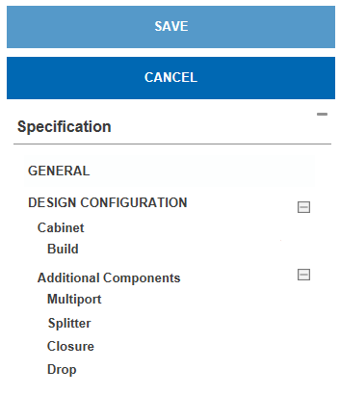
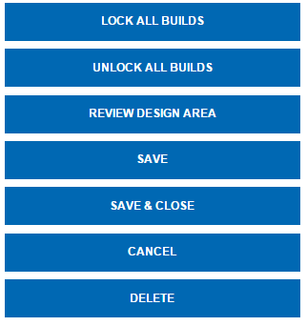
Navigating Specification Tree
Once the design is saved, more options will appear:
Lock All Builds: This will lock all builds that are complete and consistent.
Unlock All Builds: This will unlock all locked builds.
Review Design Area: Review all builds in the design area to approve or reject that are complete and consistent.
Save: Select to save and continue working.
Save & Close: Select to save and close your design area.
Cancel: Select to cancel any unsaved data.
Delete: Select to Delete design area.
Specification Tree: This will appear on the right side of the screen. As components are added to the design, they will appear on the tree.
Note: If a build has been approved post review, unlocking it will reset the review.
Save: Click this throughout the design process to save the design.
Cancel: Click Cancel to discard the design.
Notes:
After the design is saved once, more options will appear on the right hand side above the navigation tree. ‘Lock all builds’ will lock all the builds in the design area that are complete and consistent. It is important to note that if a build has errors or is not complete, it will not lock.
‘Unlock all builds’ will unlock all of the builds that are locked.
‘Review all builds’ will allow you to approve or reject any builds that are complete and consistent.
Below those options is the specification tree. As components are added to the Design area, they will appear in this section.

Slide 27
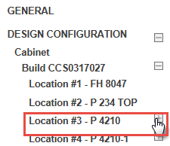
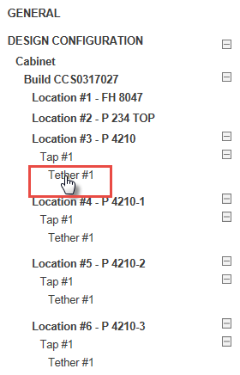
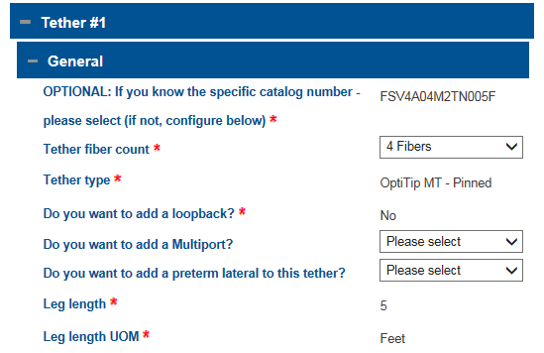
Navigating Specification Tree
As locations/taps/components are added to the design area, they will show up on the left side specification tree. Everything on the list is a hyperlink and if clicked on, will bring you to that part of the design area as shown in the screenshots below.
Note: The different levels of the specification tree are all expandable, so if you are not seeing all aspects of the design area, click the plus sign to expand.
OptiTip® MT – Pinned
Do you want to add a loop back? *
Notes:
As you add components to the design area, they will appear in the navigation tree on the right hand side of the screen. If you don’t see all components, you can click the plus sign and that will expand everything below that build or location. You can then click on any individual component of the build, and it will bring you to that section in the design area. For example, if you want to view the details of Tether #1 under location #3, you can select tether #1 and it will then bring you to the General tab beneath Tether #1.

Slide 28
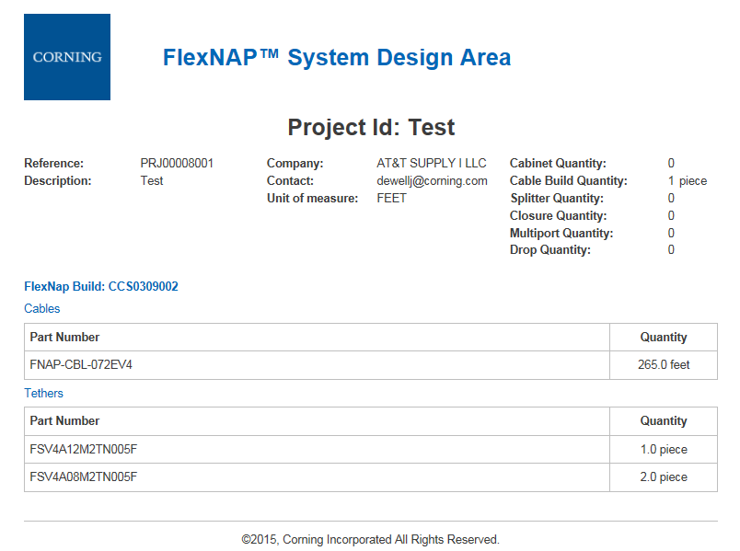
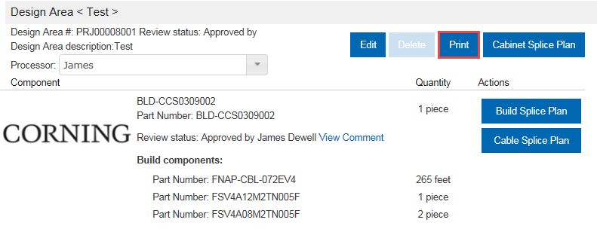
Print Build Plans
1. Select “My Design Areas” in toolbar in the top right of your screen.
This will direct you to another page that allows you to print a summary of your design area/BOM as shown below.
2. Select the name of the design area to view more options.
Project ID Test
3. Select the “Print” button in the top right corner.
Notes:
Go to ‘My Design Areas’ in the top toolbar to print your build plans. You will then see all your design areas and have to choose the one you would like to print. From there, you will see the print button on the right side. After clicking the print button, you will be directed to the page to print.

Slide 29
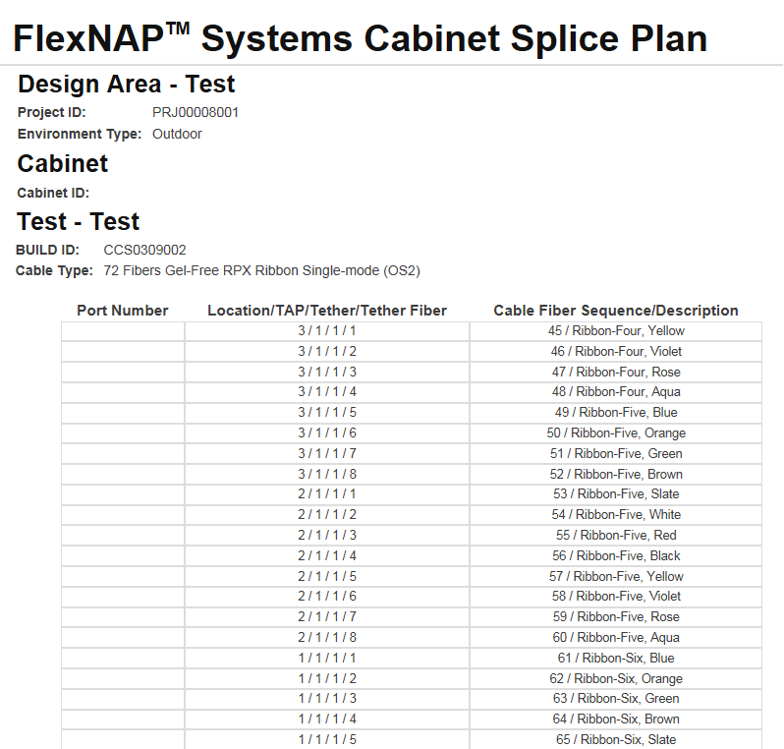
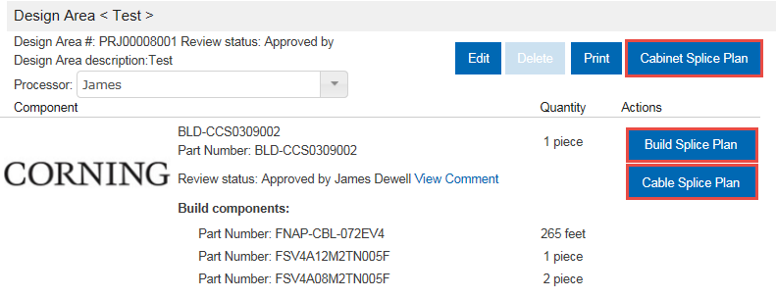
Print Build Plans
Example of Cabinet Splice Plan:
Select “Cabinet Splice Plan”, “Build Splice Plan,” and “Cable Splice Plan” to view/print the respective splice plan.
Notes:
To print splice plans, you will navigate to the same place and then select either the Cabinet Splice Plan, Build Splice Plan, or Cable Splice Plan buttons depending on what you need.

Slide 30
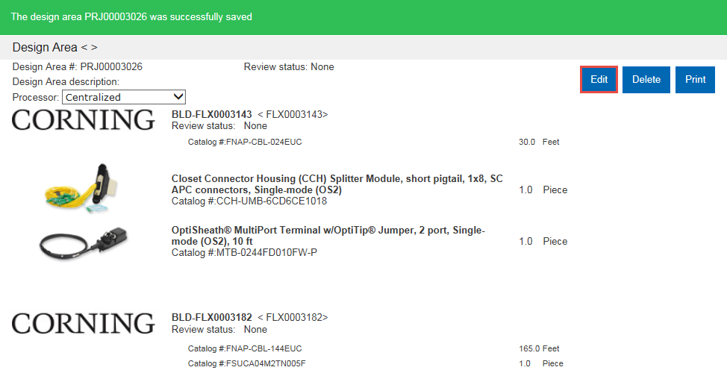
Saving and Closing
After saving and closing: After saving and closing, there will be a screen similar to below summarizing build and materials needed. If something needs to be changed, you may select the edit to re-enter the design and make changes.

Slide 31
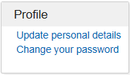
Account Management
3. In the profile section:
Select “Update personal details to change your name, email address, and phone number on the account.
Select “Change your password” to change the password used to log into the configurator.
1. In the navigation bar at the top of the screen, select “My Account”.
2. The screen below should appear.
4. Select “Get order status” to be redirected to Corning’s order tracking system.
5. Select “Manage your delivery addresses” to add/edit delivery address options for account.
Notes:
Now we will get into the account management portion. In the toolbar at the top of the screen, select the My Account button. This is where you will be able to update your personal details, change your password, get your order status, and manage your delivery addresses.

Slide 32
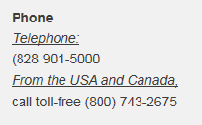
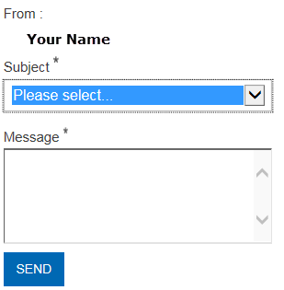
Account Management
1. Select “Contact Us” on the top navigation bar to send a message or get in contact with an administrator within COC.
3. Call the phone numbers below to get in contact with a Corning Representative.
2. Choose a subject and type a message in the text box to be sent to a Corning Administrator.
4. Email the address below to get in contact with Corning’s Customer Care Department.
Notes:
If you select Contact Us in the top toolbar, you will be able to send a message to your Corning administrator. You will also have access to the phone number and email address to reach our customer care team.

Slide 33
Account Management
Select actual hyperlink to get into dA and getting into DA
1. Select “My Design Areas” on the top navigation bar to see all design areas created on the current account.
2. The design areas should appear below. Select “View” on the right-hand side to open the individual design area.
Notes:
If you need to navigate to a specific design area, choose My Design Areas at the top of the page. You should be able to see a list of all of your design areas. From there, you can select the Key for the design area you wish to go to and you will be brought to that design area.

Slide 34
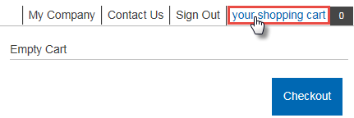
Account Management
1. Hover mouse over “your shopping cart” to receive a drop-down menu of items in your cart. Select checkout to move forward with purchase.
Notes:
To view what is in your shopping cart, you can select or hover your mouse over your shopping cart in the top right corner of the page.

Slide 35
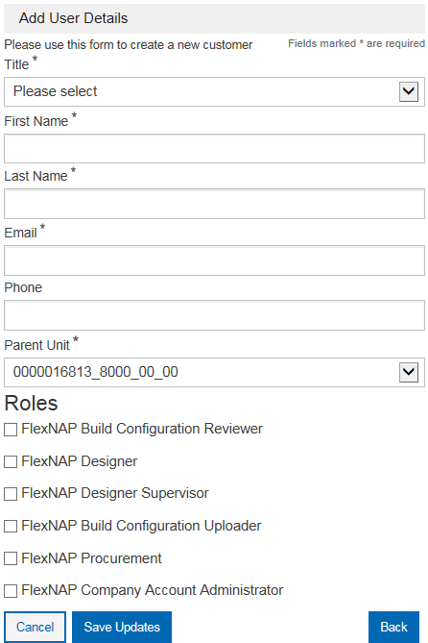
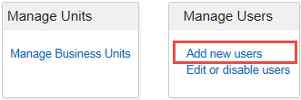
Creating Customer Accounts
Note: You must have administrative rights to create customer accounts.
1. Go to “My Company” in the toolbar in the top right corner of the screen.
2. Select “Add new users.”
FlexNAP™ Build Configuration Reviewer
FlexNAP Designer
FlexNAP Designer Supervisor
FlexNAP Build Configuration Uploader
FlexNAP Procurement
FlexNAP Company Account Administrator
3. Fill out form shown to the right. Select Role based on what the new user will be using the configurator for and click “Save Updates.”
Notes:
Now we will go on to creating customer accounts. It is important to note that you must have administrative rights to create customer accounts. If you don’t, you will not have the correct access to go through with these steps.
If you are looking to create a customer account, navigate to “My Company” in the toolbar at the top of the page. From there you will select “Add new users” in the manage users box. Then you will be prompted to enter the users details (parent unit? Ask lanie) Lastly, you will need to select the role(s) of the new user. Different roles will be able to have access to different functions within the configurator. For example: a FlexNAP designer will only be able to design the builds, while a FlexNAP designer supervisor will be able to review and approve builds.

Slide 36
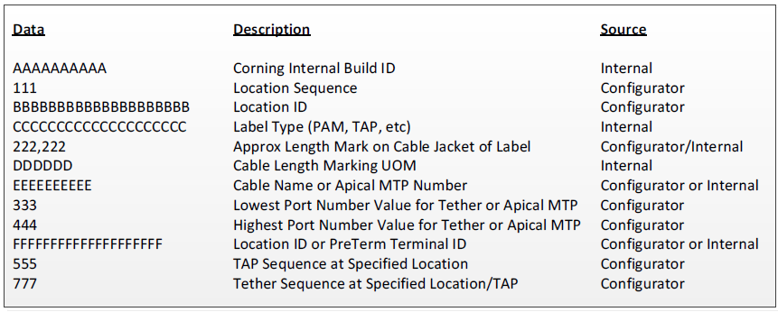
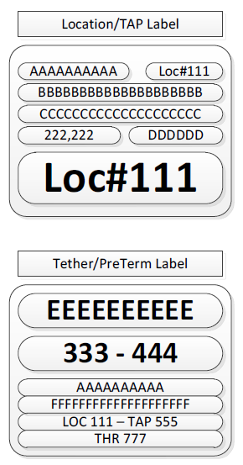
Labels
Data | Description | Source
AAAAAAAAAA | Corning Internal Build ID | COC Internal
111 | Location Sequence | Configurator
BBBBBBBBBBBBBBBBBB | Location ID | Configurator
CCCCCCCCCCCCCCCC | Label Type | COC Internal
222,222 | Approx Length Mark on Cable Jacket of Label | Configurator/COC Internal
DDDDDD | Cable Length Marking UOM | COC Internal
Data | Description | Source
EEEEEEEEEE | Cable Name or Apical MTP Number | Configurator/COC Internal
333-444 | Lowest Port Number Value- Highest Port Number Value for Tether or Apical MTP | Configurator
AAAAAAAAAAA | Corning Internal Build ID | COC Internal
FFFFFFFFFFFFFFFFFFFF | Location ID or PreTerm Terminal ID | Configurator/COC Internal
LOC 111- TAP 555 | Tap Sequence at Specified Location | Configurator
THR 777 | Tether Sequence at Specified Location/TAP | Configurator

